Slide 1
Covert Beamforming Design for Integrated Radar Sensing and Communication Systems
Paper presentation based on IEEE Transactions on Wireless Communications, Vol. 22, No. 1, January 2023
Authors: Shuai Ma, Haihong Sheng, Ruixin Yang, Hang Li, Youlong Wu, Chao Shen, Naofal Al-Dhahir, and Shiyin Li
Date of publication: 17 August 2022

Slide 2
Table of Contents
Abstract
Introduction
System Model and Problem Formulation
Beamforming Design Based on Perfect WCSI
Beamforming Design Based on Imperfect WCSI

Slide 3
Abstract
Motivation and System Idea
  Covert Beamforming for IRSC Systems
    The radar transmits probing waveforms for target sensing.
    At the same time, it covertly sends information to legitimate users.
    The communication signal is hidden under the radar probing waveform.
    The eavesdropper tries to detect whether covert communication exists.
    Objective:
      Jointly design:
        Radar detection beamformer
        Communication beamformer

Slide 4
Abstract
Motivation and System Idea
  Covert Beamforming for IRSC Systems
    Main Goal:
      Improve radar sensing and communication performance while satisfying covertness.
    Optimization Targets:
      Maximize radar detection mutual information, or
      Maximize communication rate
    Constraints:
      Covert constraint at the eavesdropper
      Communication rate requirement
      Radar detection MI requirement
      Total transmit power constraint

Slide 5
Abstract
Proposed Methods and Contributions
  Beamforming Design under Perfect and Imperfect CSI
    Perfect Eavesdropper CSI:
      The covert beamforming problems are transformed into convex subproblems.
      Semidefinite relaxation is used.
      Bisection search is applied to solve the optimization problems.
    Low-Complexity Design:
      A single-iterative beamforming scheme is proposed.
      It is based on the zero-forcing criterion.
      This reduces the complexity of iterative optimization.
    Imperfect Eavesdropper CSI:
      A robust covert beamforming framework is developed.
      Relaxation and restriction methods are used to handle CSI uncertainty.
    Main Contribution:
      The proposed schemes provide effective covert communication in IRSC systems for both perfect and imperfect eavesdropper CSI scenarios.

Slide 6
Introduction
Motivation and Research Gap
  Why Covert Communication is Needed in IRSC
    Integrated radar sensing and communication (IRSC) systems combine radar detection and wireless communication in one platform.
    Compared with separated systems, IRSC can reduce:
      Platform payload
      Power consumption
      Spectrum usage
    However, due to the open and broadcasting nature of radar waveforms, the embedded communication information may be intercepted by malicious users.
    Existing Security Limitation:
      Physical layer security mainly prevents the adversary from decoding the message.
      But it cannot hide the existence of communication itself.
    Research Gap:
      Covert communication for IRSC systems has not been well investigated.
      A rigorous covert beamforming framework is still needed.

Slide 7
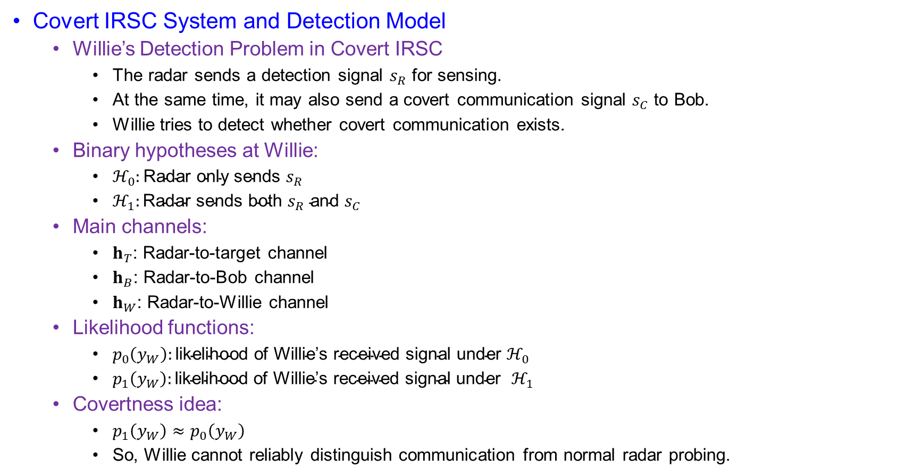
Introduction
Covert IRSC System and Detection Model
  Willie’s Detection Problem in Covert IRSC
    The radar sends a detection signal $s_{R}$ for sensing.
    At the same time, it may also send a covert communication signal $s_{C}$ to Bob.
    Willie tries to detect whether covert communication exists.
  Binary hypotheses at Willie:
    $ℋ_{0}:\text{Radar} \text{only} \text{sends} s_{R}$
    $ℋ_{1}:\text{Radar} \text{sends} \text{both} s_{R} \text{and} s_{C}$
  Main channels:
    $h_{T}$: Radar-to-target channel
    $h_{B}$: Radar-to-Bob channel
    $h_{W}$: Radar-to-Willie channel
  Likelihood functions:
    $p_{0}\left(y_{W}\right):\text{likelihood} \text{of} \text{Willie}\text{’}\text{s} \text{received} \text{signal} \text{under} ℋ_{0}$
    $p_{1}\left(y_{W}\right):\text{likelihood} \text{of} \text{Willie}\text{’}\text{s} \text{received} \text{signal} \text{under} ℋ_{1}$
  Covertness idea:
    $p_{1}\left(y_{W}\right)≈p_{0}\left(y_{W}\right)$
    So, Willie cannot reliably distinguish communication from normal radar probing.

Slide 8
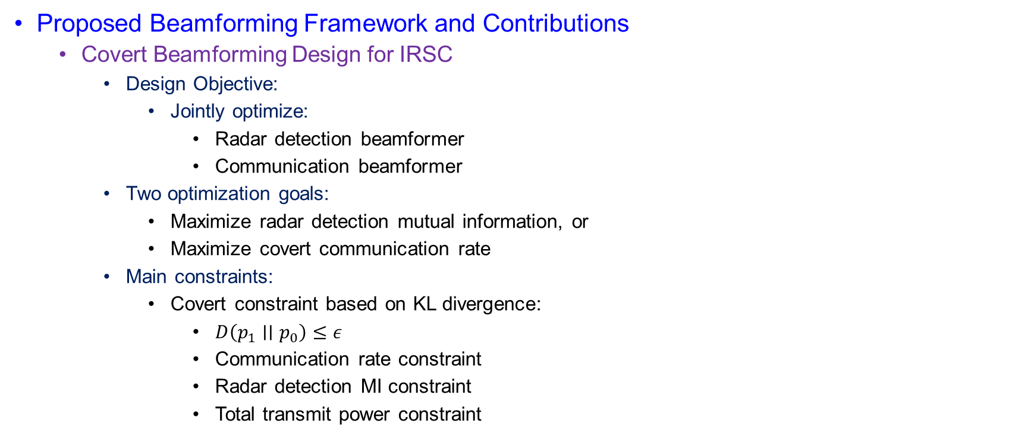
Introduction
Proposed Beamforming Framework and Contributions
  Covert Beamforming Design for IRSC
    Design Objective:
      Jointly optimize:
        Radar detection beamformer
        Communication beamformer
    Two optimization goals:
      Maximize radar detection mutual information, or
      Maximize covert communication rate
    Main constraints:
      Covert constraint based on KL divergence:
        $D\left(p_{1}∣∣p_{0}\right)≤ε$
        Communication rate constraint
        Radar detection MI constraint
        Total transmit power constraint

Slide 9
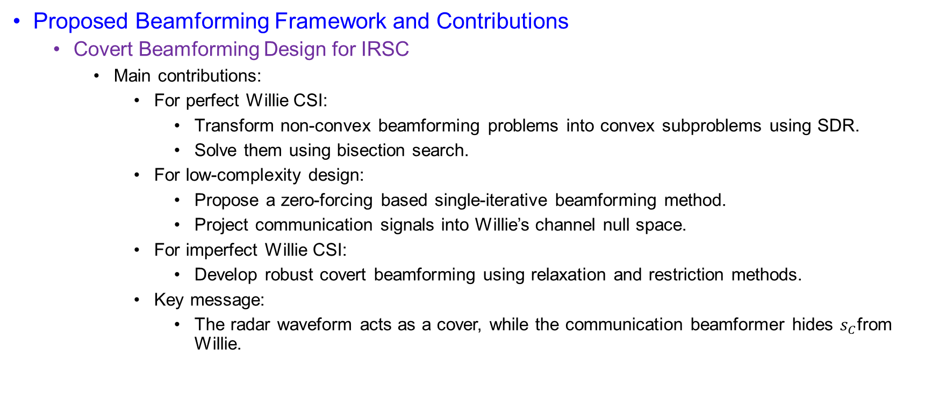
Introduction
Proposed Beamforming Framework and Contributions
  Covert Beamforming Design for IRSC
    Main contributions:
      For perfect Willie CSI:
        Transform non-convex beamforming problems into convex subproblems using SDR.
        Solve them using bisection search.
      For low-complexity design:
        Propose a zero-forcing based single-iterative beamforming method.
        Project communication signals into Willie’s channel null space.
      For imperfect Willie CSI:
        Develop robust covert beamforming using relaxation and restriction methods.
      Key message:
        The radar waveform acts as a cover, while the communication beamformer hides $s_{C}$from Willie.

Slide 10
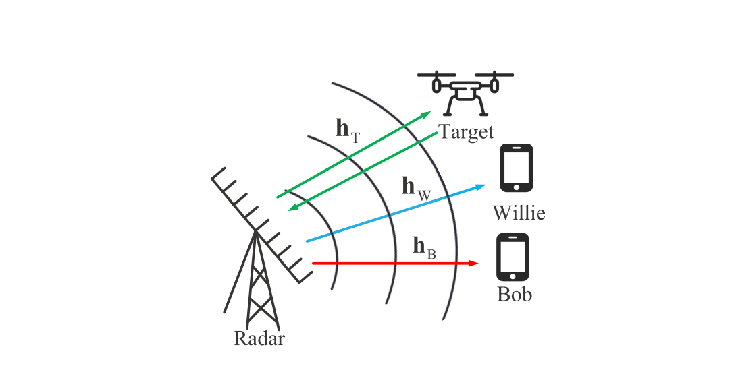
System Model
Figure 01. The schematic diagram of an integrated radar-communication system

Slide 11
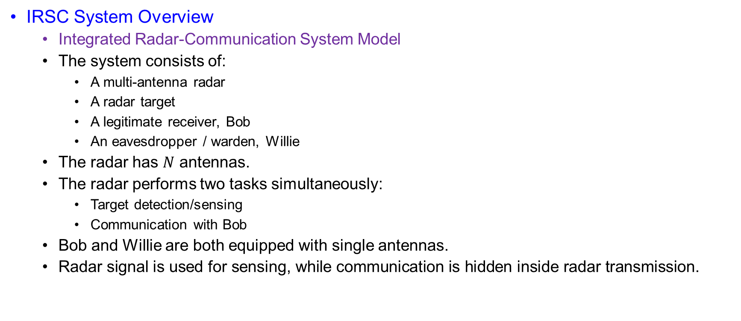
System Model
IRSC System Overview
  Integrated Radar-Communication System Model
  The system consists of:
    A multi-antenna radar
    A radar target
    A legitimate receiver, Bob
    An eavesdropper / warden, Willie
  The radar has $N$ antennas.
  The radar performs two tasks simultaneously:
    Target detection/sensing
    Communication with Bob
  Bob and Willie are both equipped with single antennas.
  $\text{Radar} \text{signal} \text{is} \text{used} \text{for} \text{sensing}\text{, }\text{while} \text{communication} \text{is} \text{hidden} \text{inside} \text{radar} \text{transmission}\text{.}$

Slide 12
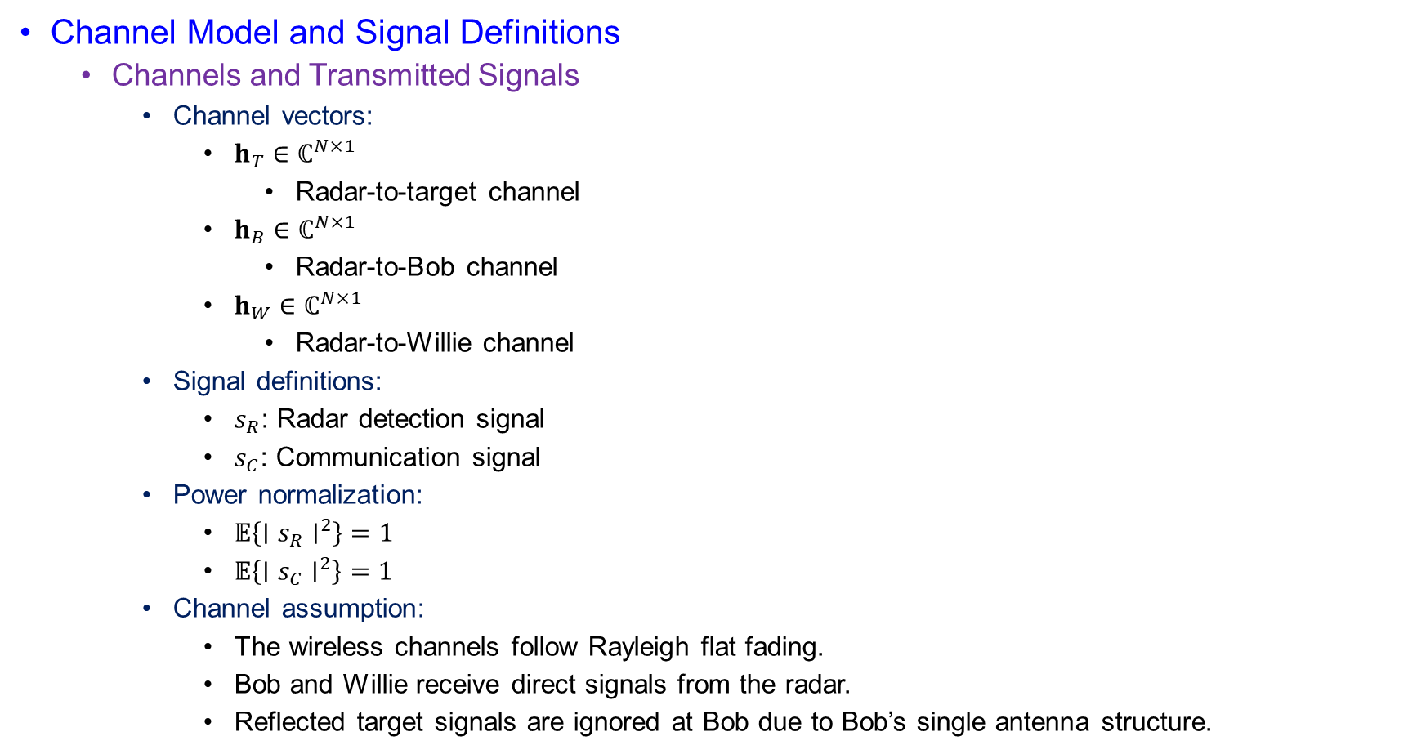
System Model
Channel Model and Signal Definitions
  Channels and Transmitted Signals
    Channel vectors:
      $h_{T}∈ℂ^{N×1}$
        Radar-to-target channel
      $h_{B}∈ℂ^{N×1}$
        Radar-to-Bob channel
      $h_{W}∈ℂ^{N×1}$
        Radar-to-Willie channel
    Signal definitions:
      $s_{R}$: Radar detection signal
      $s_{C}$: Communication signal
    Power normalization:
      $𝔼\left\{∣s_{R}∣^{2}\right\}=1$
      $𝔼\left\{∣s_{C}∣^{2}\right\}=1$
    Channel assumption:
      The wireless channels follow Rayleigh flat fading.
      Bob and Willie receive direct signals from the radar.
      Reflected target signals are ignored at Bob due to Bob’s single antenna structure.

Slide 13
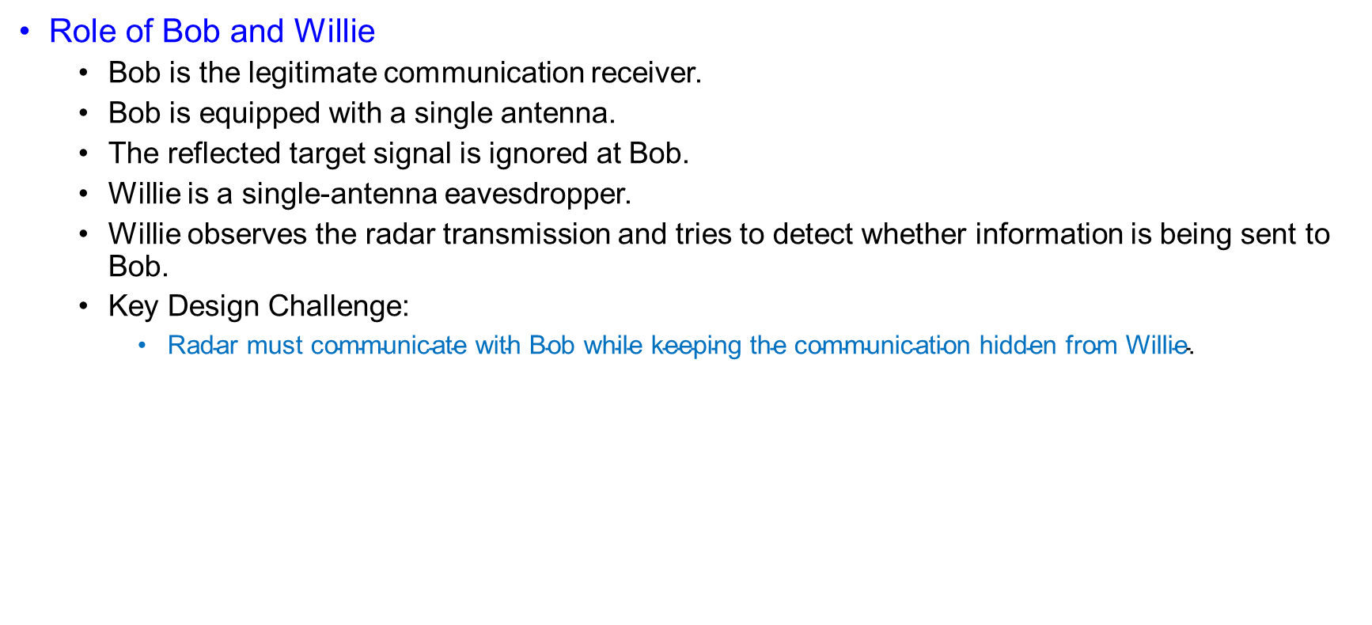
System Model
Role of Bob and Willie
  Bob is the legitimate communication receiver.
  Bob is equipped with a single antenna.
  The reflected target signal is ignored at Bob.
  Willie is a single-antenna eavesdropper.
  Willie observes the radar transmission and tries to detect whether information is being sent to Bob.
  Key Design Challenge:
    $\text{Radar} \text{must} \text{communicate} \text{with} \text{Bob} \text{while} \text{keeping} \text{the} \text{communication} \text{hidden} \text{from} \text{Willie}\text{.}$

Slide 14
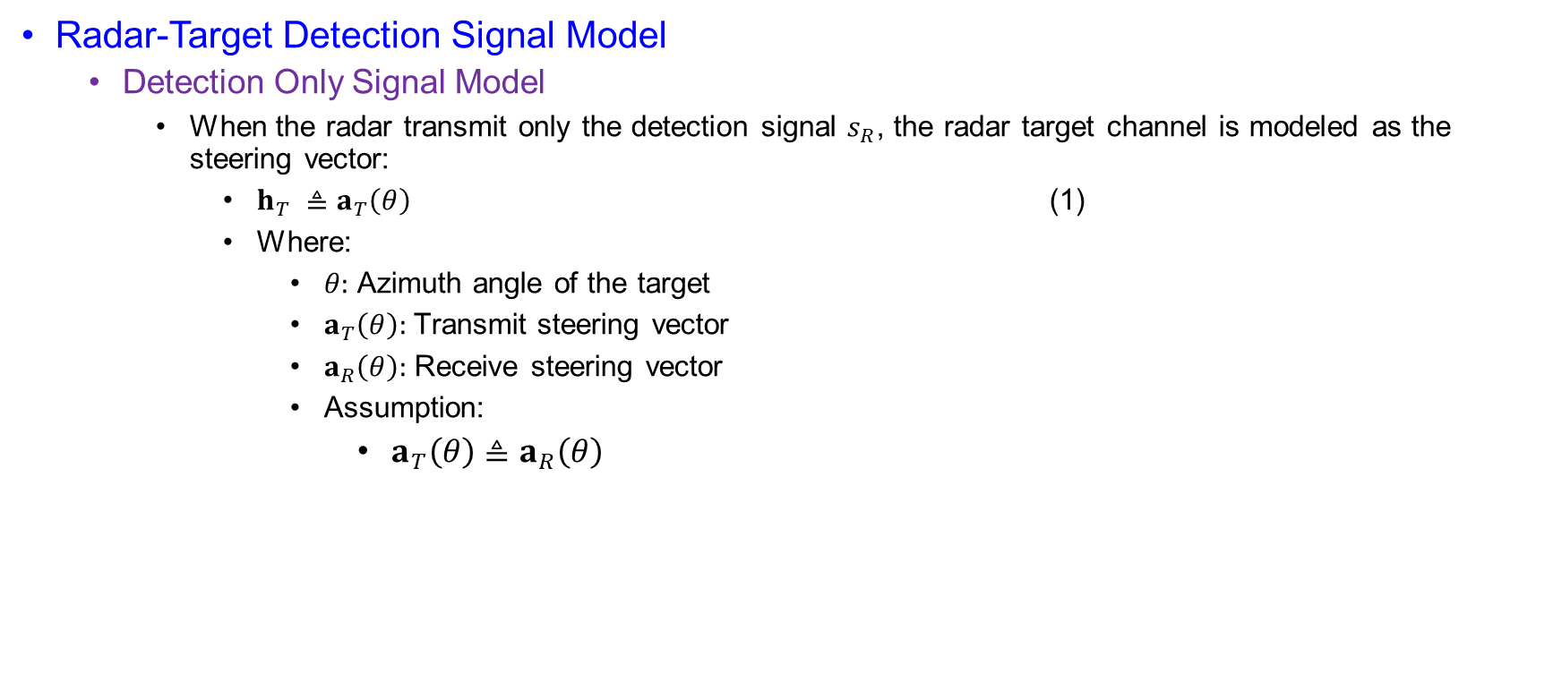
System Model
Radar-Target Detection Signal Model
  Detection Only Signal Model
    When the radar transmit only the detection signal $s_{R}$, the radar target channel is modeled as the steering vector:
      $h_{T} ≜a_{T}\left(θ\right)$ (1)
      Where:
        $θ:$ Azimuth angle of the target
        $a_{T}\left(θ\right):$Transmit steering vector
        $a_{R}\left(θ\right):$ Receive steering vector
        Assumption:
          $a_{T}\left(θ\right)≜a_{R}\left(θ\right)$

Slide 15
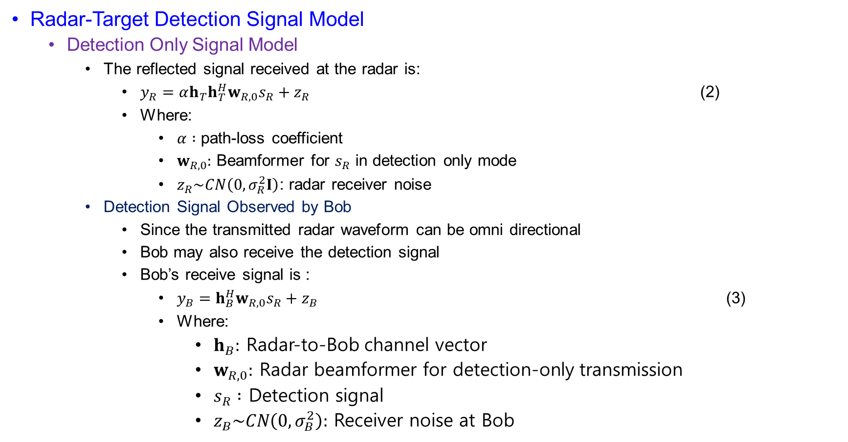
System Model
Radar-Target Detection Signal Model
  Detection Only Signal Model
    The reflected signal received at the radar is:
      $y_{R}=αh_{T}h_{T}^{H}w_{R,0}s_{R}+z_{R}$ (2)
      Where:
        $α :$ path-loss coefficient
        $w_{R,0}:$ Beamformer for $s_{R}$ in detection only mode
        $z_{R}\sim CN\left(0,σ_{R}^{2}I\right)$: radar receiver noise
    Detection Signal Observed by Bob
      Since the transmitted radar waveform can be omni directional
      Bob may also receive the detection signal
      Bob’s receive signal is :
        $y_{B}=h_{B}^{H}w_{R,0}s_{R}+z_{B}$ (3)
        Where:
          $h_{B}:$ Radar-to-Bob channel vector
          $w_{R,0}:$ Radar beamformer for detection-only transmission
          $s_{R} :$ Detection signal
          $z_{B}\sim CN\left(0,σ_{B}^{2}\right):$ Receiver noise at Bob

Slide 16
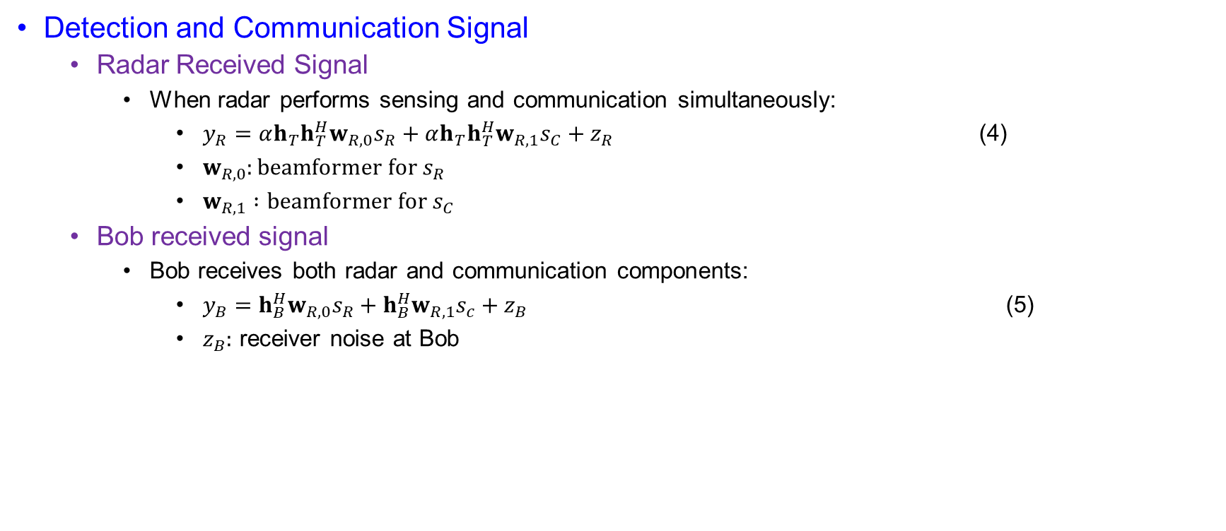
System Model
Detection and Communication Signal
  Radar Received Signal
    When radar performs sensing and communication simultaneously:
      $y_{R}=αh_{T}h_{T}^{H}w_{R,0}s_{R}+αh_{T}h_{T}^{H}w_{R,1}s_{C}+z_{R}$ (4)
      $w_{R,0}:beamformer for s_{R}$
      $w_{R,1} :beamformer for s_{C}$
  Bob received signal
    Bob receives both radar and communication components:
      $y_{B}=h_{B}^{H}w_{R,0}s_{R}+h_{B}^{H}w_{R,1}s_{c}+z_{B}$ (5)
      $z_{B}:$ receiver noise at Bob

Slide 17
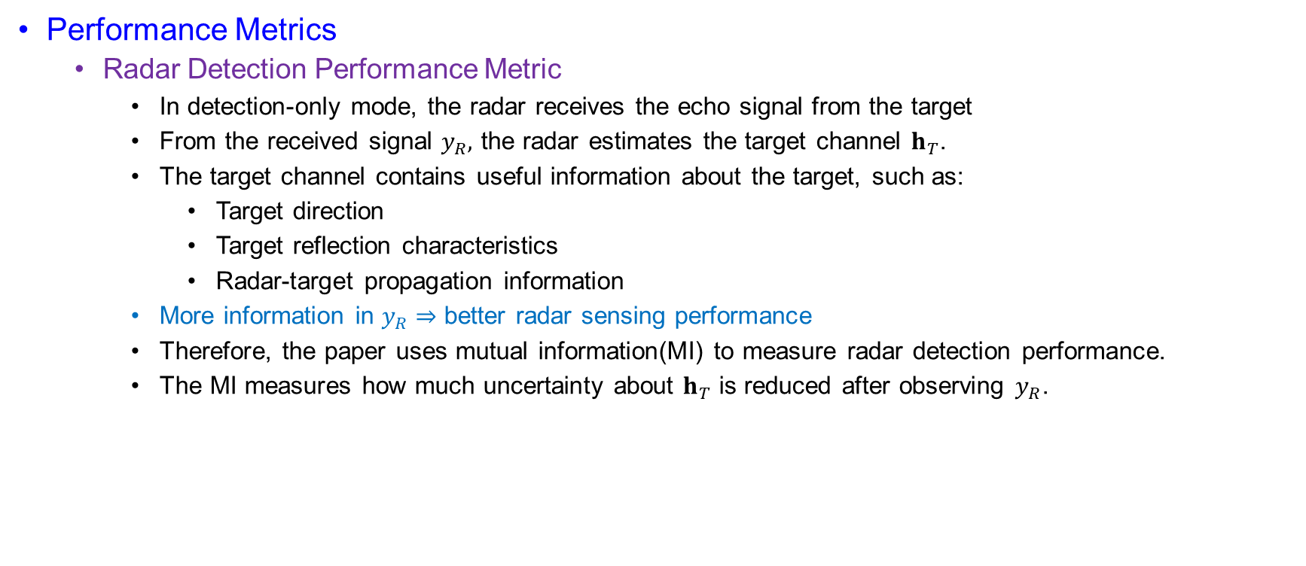
System Model
Performance Metrics
  Radar Detection Performance Metric
    In detection-only mode, the radar receives the echo signal from the target
    From the received signal $y_{R},$ the radar estimates the target channel $h_{T}$.
    The target channel contains useful information about the target, such as:
      Target direction
      Target reflection characteristics
      Radar-target propagation information
    More information in $y_{R}⇒$ better radar sensing performance
    Therefore, the paper uses mutual information(MI) to measure radar detection performance.
    The MI measures how much uncertainty about $h_{T}$ is reduced after observing $y_{R}$.

Slide 18
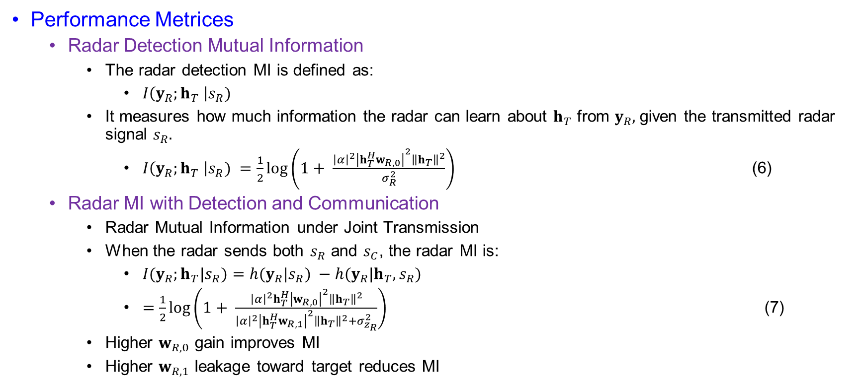
System Model
Performance Metrices
  Radar Detection Mutual Information
    The radar detection MI is defined as:
      $I\left(y_{R};h_{T} \right|s_{R})$
    It measures how much information the radar can learn about $h_{T}$ from $y_{R},$ given the transmitted radar signal $s_{R}.$
      $I\left(y_{R};h_{T} \right|s_{R}) =\frac{1}{2}\log\left(1+ \frac{{\left|α\right|}^{2}{\left|h_{T}^{H}w_{R,0}\right|}^{2}{\left\|h_{T}\right\|}^{2}}{σ_{R}^{2}}\right)$ (6)
  Radar MI with Detection and Communication
    Radar Mutual Information under Joint Transmission
    When the radar sends both $s_{R}$ and $s_{C}$, the radar MI is:
      $I(y_{R};h_{T}|s_{R})=h(y_{R}|s_{R}) −h(y_{R}|h_{T},s_{R})$
      $=\frac{1}{2}\log\left(1+ \frac{{\left|α\right|}^{2}h_{T}^{H}{\left|w_{R,0}\right|}^{2}{\left\|h_{T}\right\|}^{2}}{{\left|α\right|}^{2}{\left|h_{T}^{H}w_{R,1}\right|}^{2}{\left\|h_{T}\right\|}^{2}+σ_{z_{R}}^{2}}\right)$ (7)
    Higher $w_{R,0}$ gain improves MI
    Higher $w_{R,1}$ leakage toward target reduces MI

Slide 19

System Model
Performance Metrices
  Radar MI with Detection and Communication
    Bob Achievable Communication Rate
    Based on Bob’s received signal in (5), the achievable rate is:
      $R_{B}\left(w_{R,0},w_{R,1}\right) =\log\left(1+ \frac{{\left|h_{B}^{H}w_{R,1}\right|}^{2}}{{\left|h_{B}^{H}w_{R,0}\right|}^{2}+σ_{B}^{2}}\right)$ (8)
      Bob wants strong $s_{C}$ and weak interference from $s_{R}$

Slide 20
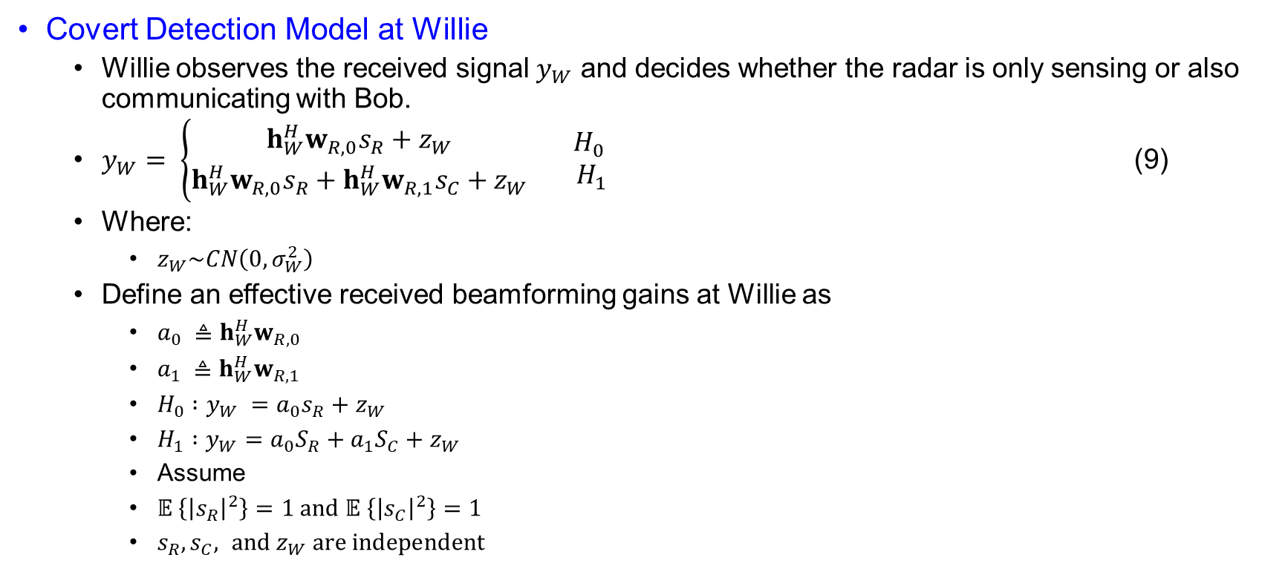
System Model
Covert Detection Model at Willie
  Willie observes the received signal $y_{W}$ and decides whether the radar is only sensing or also communicating with Bob.
  $y_{W}= \left\{\begin{aligned}h_{W}^{H}w_{R,0}s_{R}+z_{W} \\ h_{W}^{H}w_{R,0}s_{R}+h_{W}^{H}w_{R,1}s_{C}+z_{W}\end{aligned}\right.\begin{matrix}{ H}_{0} \\ { H}_{1}\end{matrix}$ (9)
  Where:
    $z_{W}\sim CN\left(0,σ_{W}^{2}\right)$
  Define an effective received beamforming gains at Willie as
    $a_{0} ≜h_{W}^{H}w_{R,0}$
    $a_{1} ≜h_{W}^{H}w_{R,1}$
    $H_{0} :y_{W} =a_{0}s_{R}+z_{W}$
    $H_{1} :y_{W}=a_{0}S_{R}+a_{1}S_{C}+z_{W}$
    Assume
    $𝔼 \left\{{\left|s_{R}\right|}^{2}\right\}=1 and 𝔼 \left\{{\left|s_{C}\right|}^{2}\right\}=1$
    $s_{R}, s_{C}, and z_{W} are independent$

Slide 21
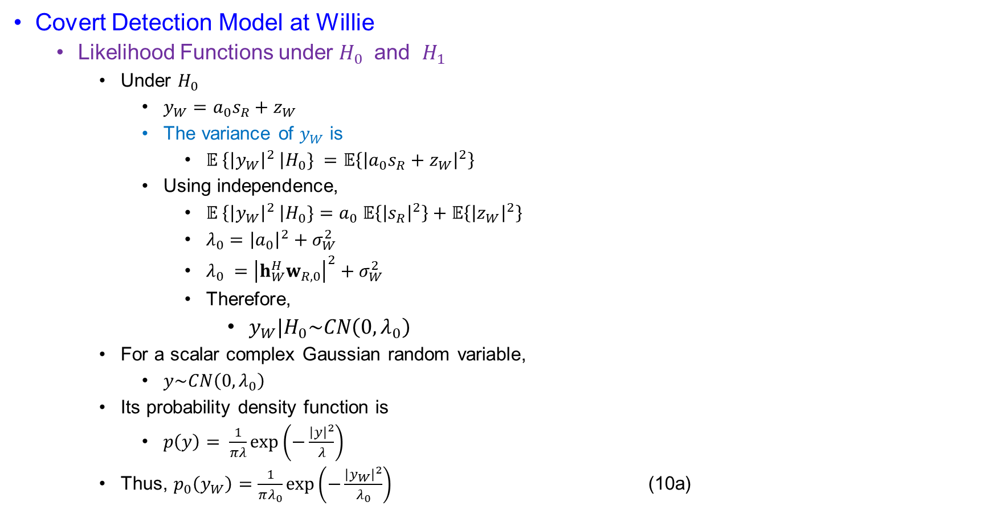
System Model
Covert Detection Model at Willie
  Likelihood Functions under $H_{0}$ and $H_{1}$
    Under $H_{0}$
      $y_{W}=a_{0}s_{R}+z_{W}$
      The variance of $y_{W}$ is
        $𝔼 \left\{{\left|y_{W}\right|}^{2} \right|H_{0}\} =𝔼\left\{{\left|a_{0}s_{R}+z_{W}\right|}^{2}\right\}$
      Using independence,
        $𝔼 \left\{{\left|y_{W}\right|}^{2} \right|H_{0}\}=a_{0} 𝔼\left\{{\left|s_{R}\right|}^{2}\right\}+𝔼\left\{{\left|z_{W}\right|}^{2}\right\}$
        $λ_{0}={\left|a_{0}\right|}^{2}+σ_{W}^{2}$
        $λ_{0} ={\left|h_{W}^{H}w_{R,0}\right|}^{2}+σ_{W}^{2}$
        Therefore,
          $y_{W}|H_{0}\sim CN\left(0,λ_{0}\right)$
    For a scalar complex Gaussian random variable,
      $y\sim CN\left(0,λ_{0}\right)$
    Its probability density function is
      $p\left(y\right)= \frac{1}{πλ}\exp\left(−\frac{{\left|y\right|}^{2}}{λ}\right)$
    Thus, $p_{0}\left(y_{W}\right)=\frac{1}{πλ_{0}}\exp\left(−\frac{{\left|y_{W}\right|}^{2}}{λ_{0}}\right)$ (10a)

Slide 22
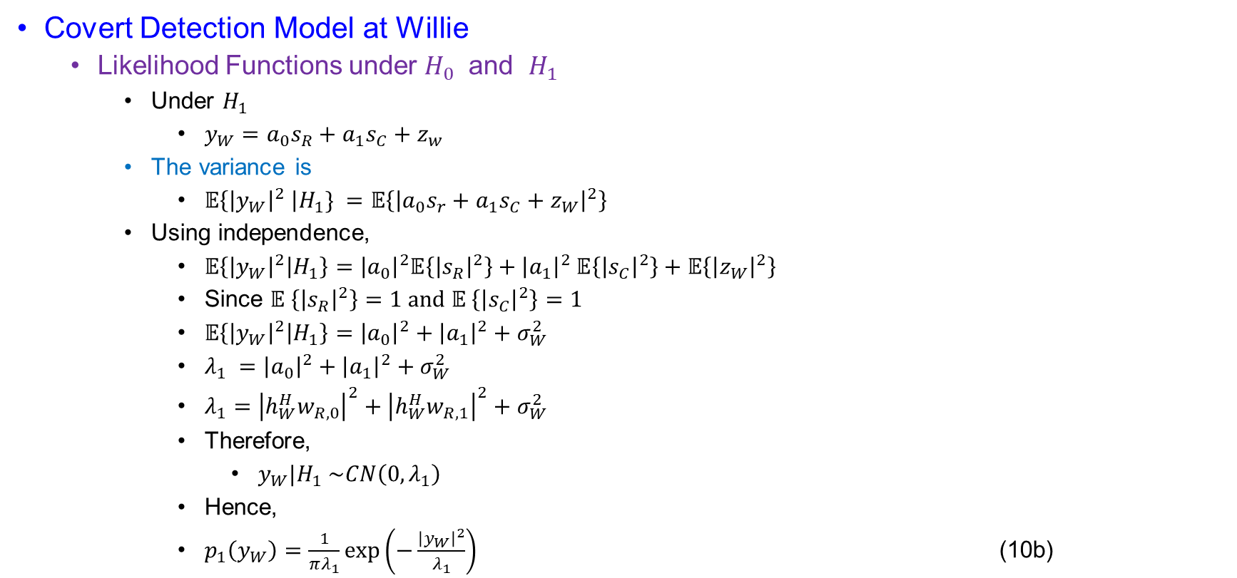
System Model
Covert Detection Model at Willie
  Likelihood Functions under $H_{0}$ and $H_{1}$
    Under $H_{1}$
      $y_{W}=a_{0}s_{R}+a_{1}s_{C}+z_{w}$
    The variance is
      $𝔼\left\{{\left|y_{W}\right|}^{2} \right|H_{1}\} =𝔼\left\{{\left|a_{0}s_{r}+a_{1}s_{C}+z_{W}\right|}^{2}\right\}$
    Using independence,
      $𝔼\left\{{\left|y_{W}\right|}^{2} | H_{1}\right\}={\left|a_{0}\right|}^{2}𝔼\left\{{\left|s_{R}\right|}^{2}\right\}+{\left|a_{1}\right|}^{2} 𝔼\left\{{\left|s_{C}\right|}^{2}\right\}+𝔼\left\{{\left|z_{W}\right|}^{2}\right\}$
      Since $𝔼 \left\{{\left|s_{R}\right|}^{2}\right\}=1 and 𝔼 \left\{{\left|s_{C}\right|}^{2}\right\}=1$
      $𝔼\left\{{\left|y_{W}\right|}^{2} | H_{1}\right\}={\left|a_{0}\right|}^{2}+{\left|a_{1}\right|}^{2}+σ_{W}^{2}$
      $λ_{1} ={\left|a_{0}\right|}^{2}+{\left|a_{1}\right|}^{2}+σ_{W}^{2}$
      $λ_{1}={\left|h_{W}^{H}w_{R,0}\right|}^{2}+{\left|h_{W}^{H}w_{R,1}\right|}^{2}+σ_{W}^{2}$
      Therefore,
        $y_{W}|H_{1} \sim CN\left(0,λ_{1}\right)$
      Hence,
      $p_{1}\left(y_{W}\right)=\frac{1}{πλ_{1}}\exp\left(−\frac{{\left|y_{W}\right|}^{2}}{λ_{1}}\right)$ (10b)

Slide 23
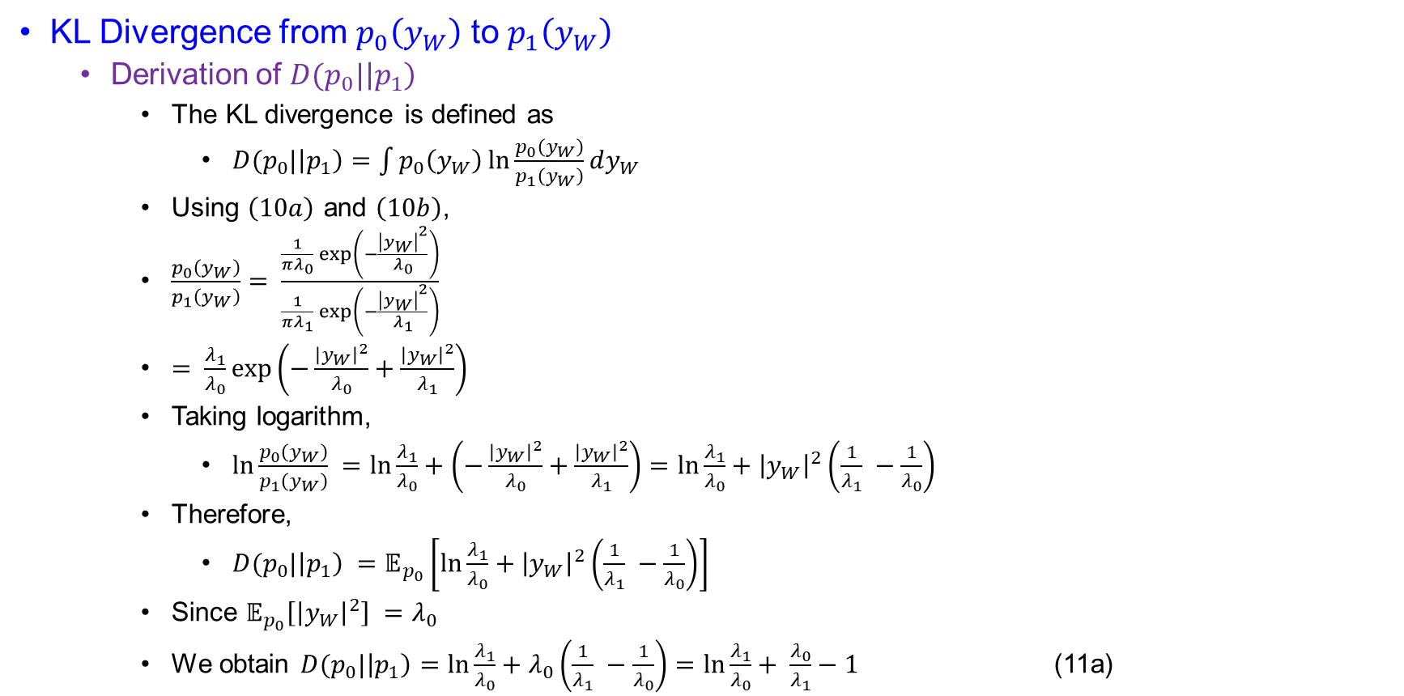
System Model
KL Divergence from $p_{0}\left(y_{W}\right)$ to $p_{1}\left(y_{W}\right)$
  Derivation of $D(p_{0}|\left|p_{1}\right)$
    The KL divergence is defined as
      $D(p_{0}|\left|p_{1}\right)=\int{p_{0}\left(y_{W}\right)\ln{\frac{p_{0}\left(y_{W}\right)}{p_{1}\left(y_{W}\right)}}}dy_{W}$
    Using $\left(10a\right)$ and $\left(10b\right)$,
    $\frac{p_{0}\left(y_{W}\right)}{p_{1}\left(y_{W}\right)}= \frac{\frac{1}{πλ_{0}}\exp\left(−\frac{{\left|y_{W}\right|}^{2}}{λ_{0}}\right)}{\frac{1}{πλ_{1}}\exp\left(−\frac{{\left|y_{W}\right|}^{2}}{λ_{1}}\right)}$
    $= \frac{λ_{1}}{λ_{0}}\exp\left(−\frac{{\left|y_{W}\right|}^{2}}{λ_{0}}+\frac{{\left|y_{W}\right|}^{2}}{λ_{1}}\right)$
    Taking logarithm,
      $\ln{\frac{p_{0}\left(y_{W}\right)}{p_{1}\left(y_{W}\right)} =\ln{\frac{λ_{1}}{λ_{0}}+\left(−\frac{{\left|y_{W}\right|}^{2}}{λ_{0}}+\frac{{\left|y_{W}\right|}^{2}}{λ_{1}}\right)}=\ln{\frac{λ_{1}}{λ_{0}}+{\left|y_{W}\right|}^{2}\left(\frac{1}{λ_{1}} −\frac{1}{λ_{0}}\right)}}$
    Therefore,
      $D(p_{0}|\left|p_{1}\right) =𝔼_{p_{0}}\left[\ln{\frac{λ_{1}}{λ_{0}}+{\left|y_{W}\right|}^{2}\left(\frac{1}{λ_{1}} −\frac{1}{λ_{0}}\right)}\right]$
    Since $𝔼_{p_{0}}\left[{\left|y_{W}\right|}^{2}\right] =λ_{0}$
    We obtain $D(p_{0}|\left|p_{1}\right)=\ln{\frac{λ_{1}}{λ_{0}}+λ_{0}\left(\frac{1}{λ_{1}} −\frac{1}{λ_{0}}\right)}=\ln{\frac{λ_{1}}{λ_{0}}+ \frac{λ_{0}}{λ_{1}}−1 }$ (11a)

Slide 24
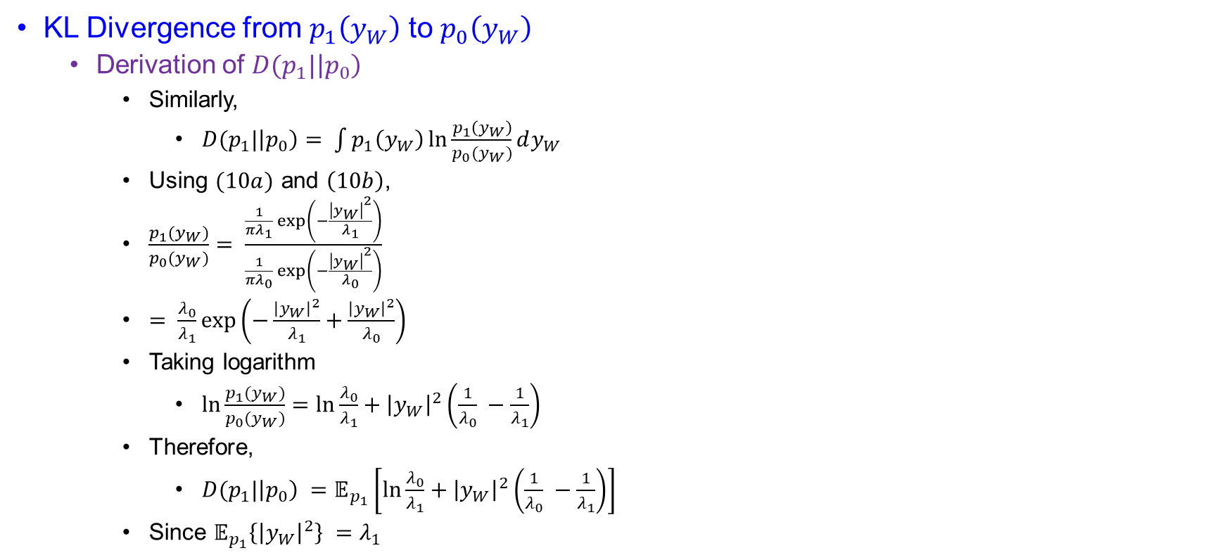
System Model
KL Divergence from $p_{1}\left(y_{W}\right)$ to $p_{0}\left(y_{W}\right)$
  Derivation of $D(p_{1}|\left|p_{0}\right)$
    Similarly,
      $D(p_{1}|\left|p_{0}\right)= \int{p_{1}\left(y_{W}\right)\ln{\frac{p_{1}\left(y_{W}\right)}{p_{0}(y_{W})}dy_{W}}}$
    Using $(10a)$ and $\left(10b\right)$,
    $\frac{p_{1}(y_{W})}{p_{0}(y_{W})}= \frac{\frac{1}{πλ_{1}}\exp\left(−\frac{{\left|y_{W}\right|}^{2}}{λ_{1}}\right)}{\frac{1}{πλ_{0}}\exp\left(−\frac{{\left|y_{W}\right|}^{2}}{λ_{0}}\right)}$
    $= \frac{λ_{0}}{λ_{1}}\exp\left(−\frac{{\left|y_{W}\right|}^{2}}{λ_{1}}+\frac{{\left|y_{W}\right|}^{2}}{λ_{0}}\right)$
    Taking logarithm
      $\ln{\frac{p_{1}(y_{W})}{p_{0}(y_{W})}=\ln{\frac{λ_{0}}{λ_{1}}}+{\left|y_{W}\right|}^{2}\left(\frac{1}{λ_{0}} −\frac{1}{λ_{1}}\right)}$
    Therefore,
      $D(p_{1}|\left|p_{0}\right) =𝔼_{p_{1}}\left[\ln{\frac{λ_{0}}{λ_{1}}}+{\left|y_{W}\right|}^{2}\left(\frac{1}{λ_{0}} −\frac{1}{λ_{1}}\right)\right]$
    Since $𝔼_{p_{1}}\left\{{\left|y_{W}\right|}^{2}\right\} =λ_{1}$

Slide 25
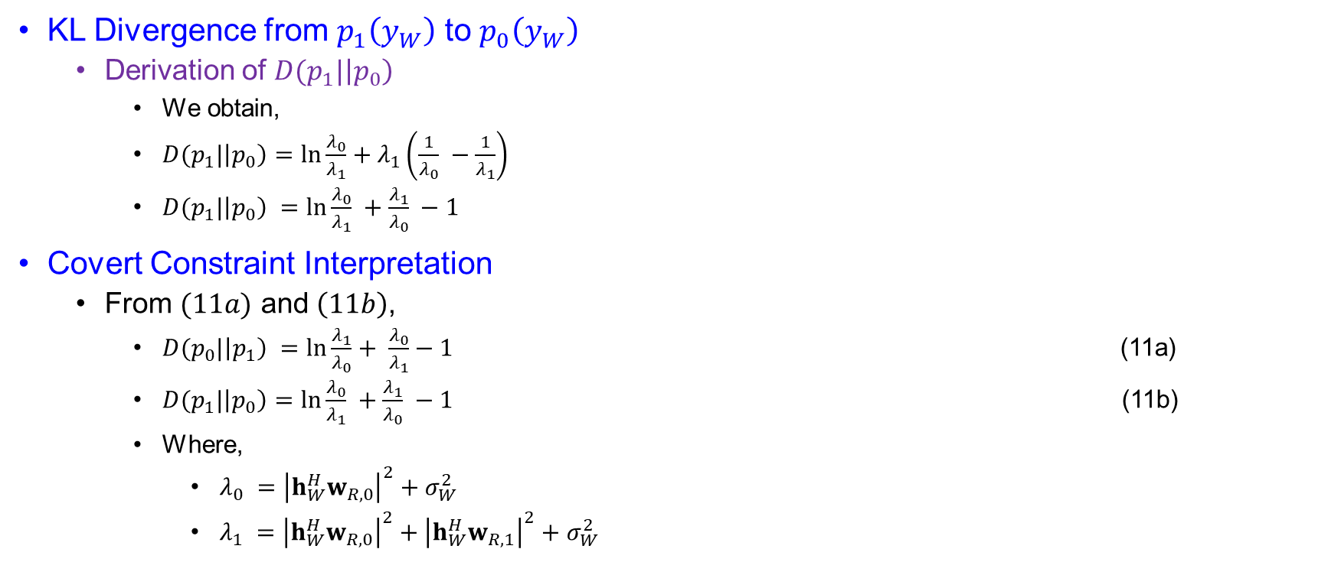
System Model
KL Divergence from $p_{1}\left(y_{W}\right)$ to $p_{0}\left(y_{W}\right)$
  Derivation of $D(p_{1}|\left|p_{0}\right)$
    We obtain,
    $D(p_{1}|\left|p_{0}\right)=\ln{\frac{λ_{0}}{λ_{1}}+λ_{1}\left(\frac{1}{λ_{0}} −\frac{1}{λ_{1}}\right)}$
    $D(p_{1}|\left|p_{0}\right) =\ln{\frac{λ_{0}}{λ_{1}} +\frac{λ_{1}}{λ_{0}} −1}$
Covert Constraint Interpretation
  From $(11a)$ and $\left(11b\right)$,
    $D(p_{0}|\left|p_{1}\right) =\ln{\frac{λ_{1}}{λ_{0}}+ \frac{λ_{0}}{λ_{1}}−1 }$ (11a)
    $D(p_{1}|\left|p_{0}\right)=\ln{\frac{λ_{0}}{λ_{1}} +\frac{λ_{1}}{λ_{0}} −1}$ (11b)
    Where,
      $λ_{0} ={\left|h_{W}^{H}w_{R,0}\right|}^{2}+σ_{W}^{2}$
      $λ_{1} ={\left|h_{W}^{H}w_{R,0}\right|}^{2}+{\left|h_{W}^{H}w_{R,1}\right|}^{2}+σ_{W}^{2}$

Slide 26
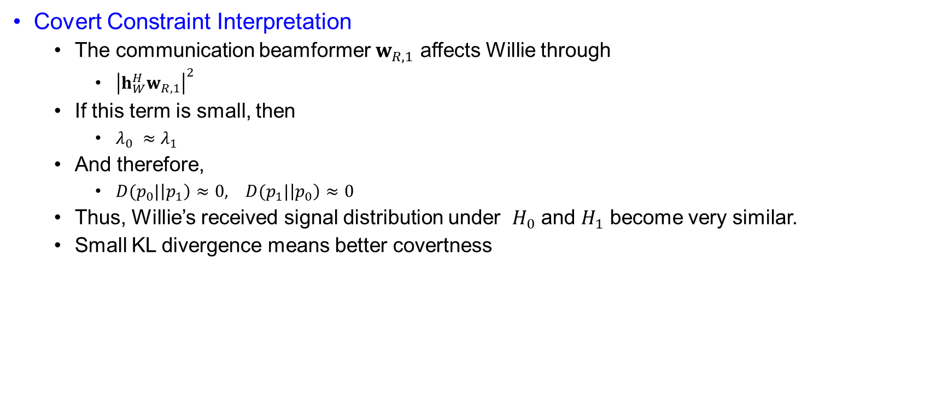
System Model
Covert Constraint Interpretation
  The communication beamformer $w_{R,1}$ affects Willie through
    ${\left|h_{W}^{H}w_{R,1}\right|}^{2}$
  If this term is small, then
    $λ_{0} ≈λ_{1}$
  And therefore,
    $D(p_{0}|\left|p_{1}\right)≈0, D(p_{1}|\left|p_{0}\right)≈0$
  Thus, Willie’s received signal distribution under $H_{0}$ and $H_{1}$ become very similar.
  Small KL divergence means better covertness

Slide 27
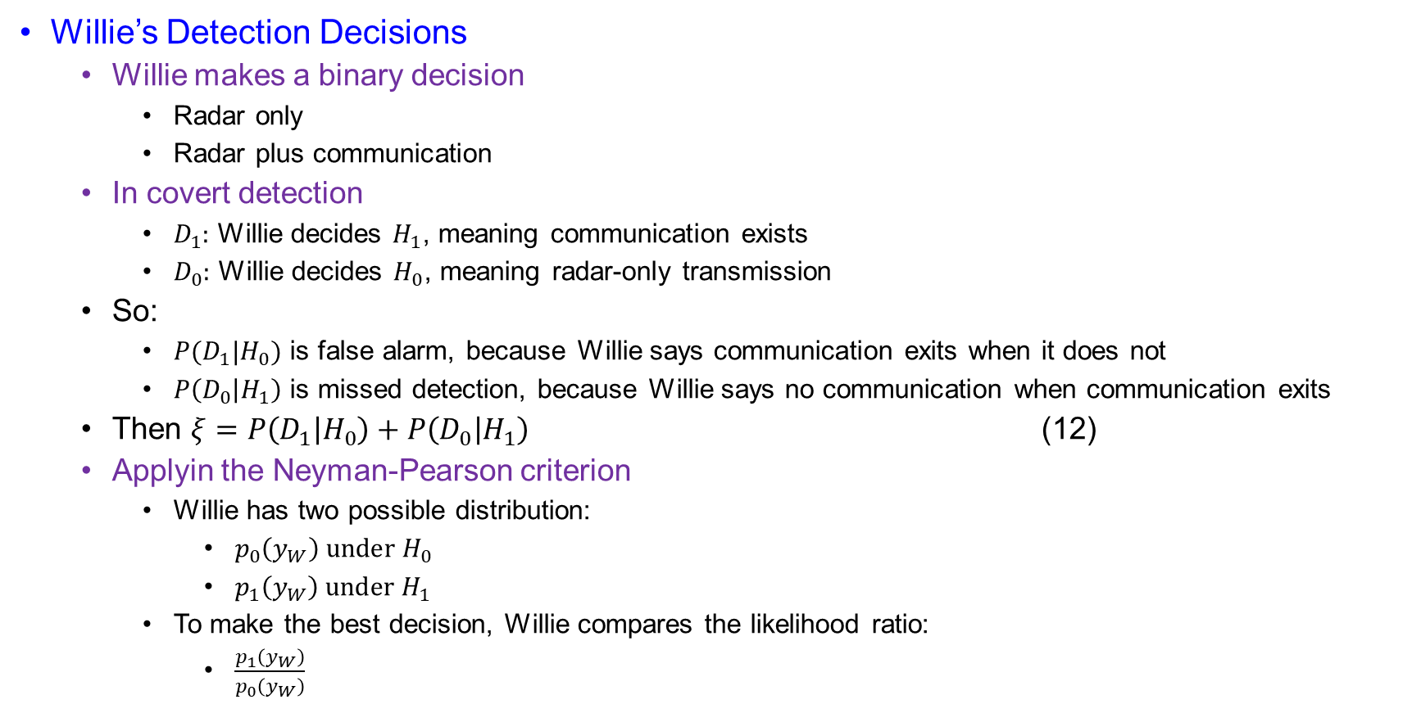
System Model
Willie’s Detection Decisions
  Willie makes a binary decision
    Radar only
    Radar plus communication
  In covert detection
    $D_{1}:$ Willie decides $H_{1}$, meaning communication exists
    $D_{0}:$ Willie decides $H_{0}$, meaning radar-only transmission
  So:
    $P(D_{1}|H_{0})$ is false alarm, because Willie says communication exits when it does not
    $P\left(D_{0} | H_{1}\right)$ is missed detection, because Willie says no communication when communication exits
  Then $ξ=P\left(D_{1} | H_{0}\right)+P\left(D_{0} | H_{1}\right)$ (12)
  Applyin the Neyman-Pearson criterion
    Willie has two possible distribution:
      $p_{0}\left(y_{W}\right) under H_{0}$
      $p_{1}\left(y_{W}\right) under H_{1}$
    To make the best decision, Willie compares the likelihood ratio:
      $\frac{p_{1}\left(y_{W}\right)}{p_{0}\left(y_{W}\right)}$

Slide 28
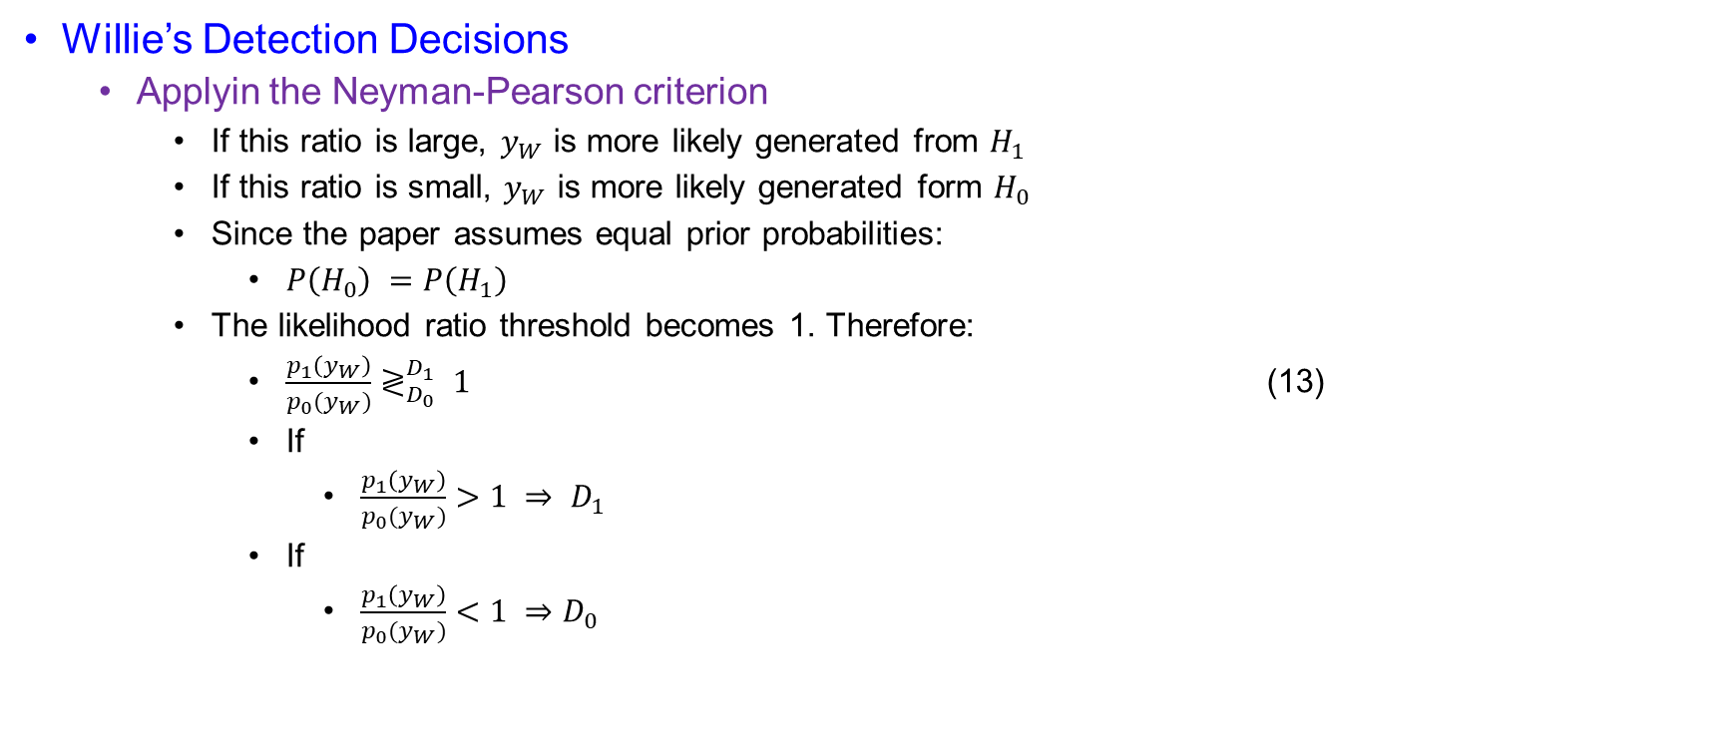
System Model
Willie’s Detection Decisions
  Applyin the Neyman-Pearson criterion
    If this ratio is large, $y_{W}$ is more likely generated from $H_{1}$
    If this ratio is small, $y_{W}$ is more likely generated form $H_{0}$
    Since the paper assumes equal prior probabilities:
      $P\left(H_{0}\right) =P\left(H_{1}\right)$
    The likelihood ratio threshold becomes 1. Therefore:
      $\frac{p_{1}\left(y_{W}\right)}{p_{0}(y_{W})}≷_{D_{0}}^{D_{1}} 1$ (13)
      If
        $\frac{p_{1}\left(y_{W}\right)}{p_{0}(y_{W})}>1 ⇒ D_{1}$
      If
        $\frac{p_{1}\left(y_{W}\right)}{p_{0}(y_{W})}<1 ⇒D_{0}$

Slide 29
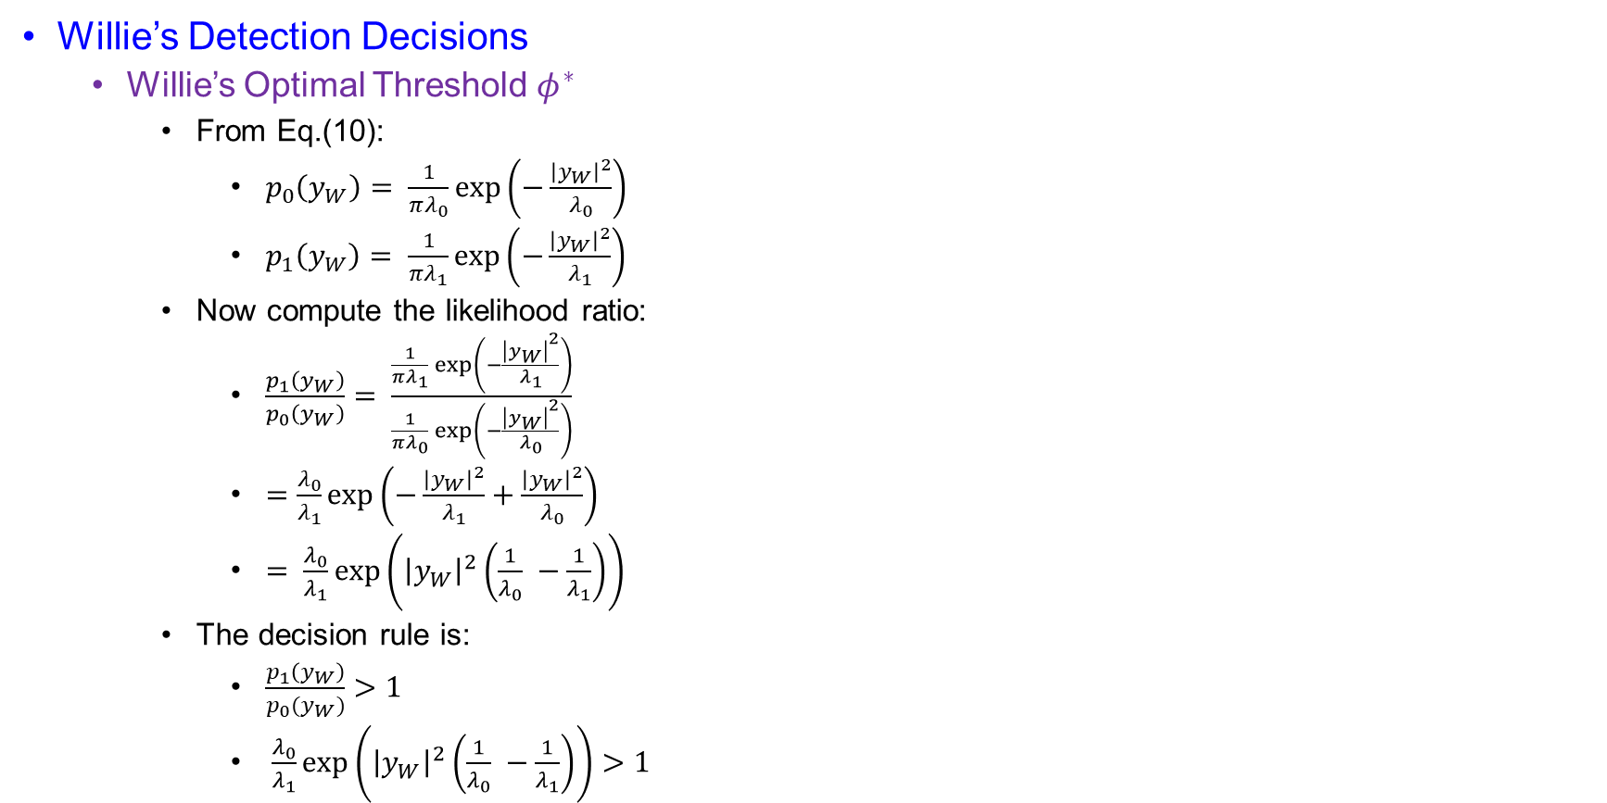
System Model
Willie’s Detection Decisions
  Willie’s Optimal Threshold $φ^{∗}$
    From Eq.(10):
      $p_{0}\left(y_{W}\right)= \frac{1}{πλ_{0}}\exp\left(−\frac{{\left|y_{W}\right|}^{2}}{λ_{0}}\right)$
      $p_{1}\left(y_{W}\right)= \frac{1}{πλ_{1}}\exp\left(−\frac{{\left|y_{W}\right|}^{2}}{λ_{1}}\right)$
    Now compute the likelihood ratio:
      $\frac{p_{1}\left(y_{W}\right)}{p_{0}\left(y_{W}\right)}= \frac{\frac{1}{πλ_{1}}\exp\left(−\frac{{\left|y_{W}\right|}^{2}}{λ_{1}}\right)}{\frac{1}{πλ_{0}}\exp\left(−\frac{{\left|y_{W}\right|}^{2}}{λ_{0}}\right)}$
      $=\frac{λ_{0}}{λ_{1}}\exp\left(−\frac{{\left|y_{W}\right|}^{2}}{λ_{1}}+\frac{{\left|y_{W}\right|}^{2}}{λ_{0}}\right)$
      $= \frac{λ_{0}}{λ_{1}}\exp\left({\left|y_{W}\right|}^{2}\left(\frac{1}{λ_{0}} −\frac{1}{λ_{1}}\right)\right)$
    The decision rule is:
      $\frac{p_{1}\left(y_{W}\right)}{p_{0}(y_{W})}>1$
      $\frac{λ_{0}}{λ_{1}}\exp\left({\left|y_{W}\right|}^{2}\left(\frac{1}{λ_{0}} −\frac{1}{λ_{1}}\right)\right)>1$

Slide 30
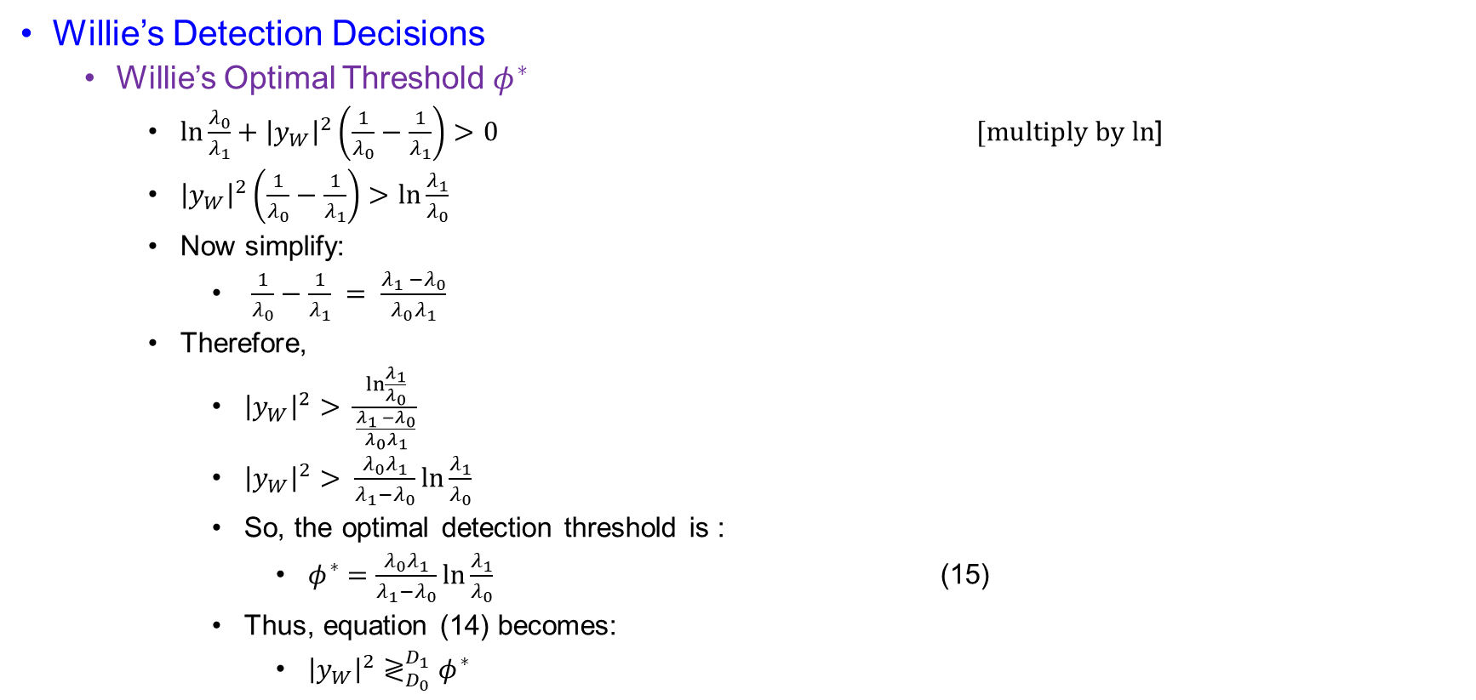
System Model
Willie’s Detection Decisions
  Willie’s Optimal Threshold $φ^{∗}$
    $\ln{\frac{λ_{0}}{λ_{1}}+{\left|y_{W}\right|}^{2}\left(\frac{1}{λ_{0}}−\frac{1}{λ_{1}}\right)>0}$ $[multiply by ln$]
    ${\left|y_{W}\right|}^{2}\left(\frac{1}{λ_{0}}−\frac{1}{λ_{1}}\right)>\ln{\frac{λ_{1}}{λ_{0}}}$
    Now simplify:
      $\frac{1}{λ_{0}}−\frac{1}{λ_{1}} = \frac{λ_{1} −λ_{0}}{λ_{0}λ_{1}}$
    Therefore,
      ${\left|y_{W}\right|}^{2}> \frac{\ln{\frac{λ_{1}}{λ_{0}}}}{\frac{λ_{1} −λ_{0}}{λ_{0}λ_{1}}}$
      ${\left|y_{W}\right|}^{2}> \frac{λ_{0}λ_{1}}{λ_{1}−λ_{0}}\ln{\frac{λ_{1}}{λ_{0}}}$
      So, the optimal detection threshold is :
        $φ^{∗}=\frac{λ_{0}λ_{1}}{λ_{1}−λ_{0}}\ln{\frac{λ_{1}}{λ_{0}}}$ (15)
      Thus, equation (14) becomes:
        ${\left|y_{W}\right|}^{2}≷_{D_{0}}^{D_{1}}φ^{∗}$

Slide 31
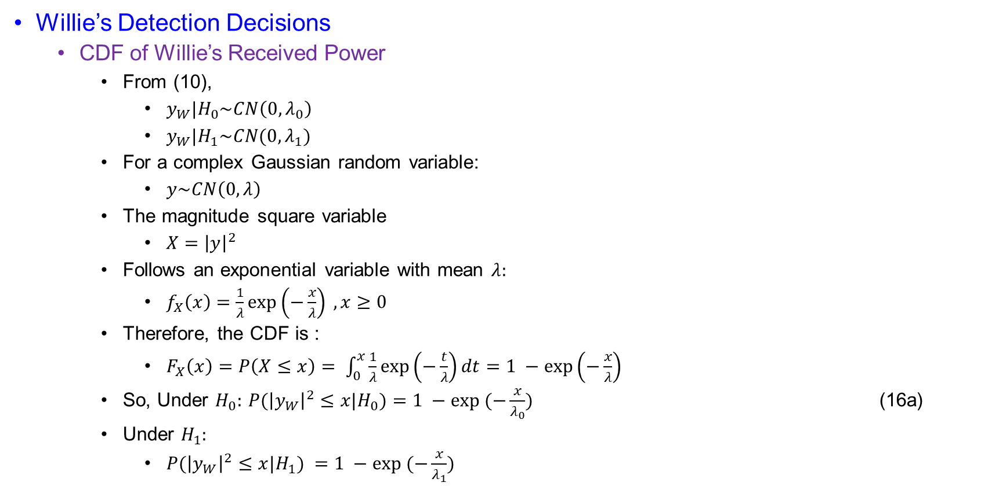
System Model
Willie’s Detection Decisions
  CDF of Willie’s Received Power
    From (10),
      $y_{W}|H_{0}\sim CN\left(0,λ_{0}\right)$
      $y_{W}|H_{1}\sim CN(0,λ_{1})$
    For a complex Gaussian random variable:
      $y\sim CN\left(0,λ\right)$
    The magnitude square variable
      $X={\left|y\right|}^{2}$
    Follows an exponential variable with mean $λ:$
      $f_{X}\left(x\right)=\frac{1}{λ}\exp\left(−\frac{x}{λ}\right) , x≥0$
    Therefore, the CDF is :
      $F_{X}\left(x\right)=P\left(X≤x\right)= \int_{0}^{x}{\frac{1}{λ}\exp\left(−\frac{t}{λ}\right)dt=1 −\exp\left(−\frac{x}{λ}\right)}$
    So, Under $H_{0}:$ $P({\left|y_{W}\right|}^{2}≤x|H_{0})=1 −exp⁡ (−\frac{x}{λ_{0}})$ (16a)
    Under $H_{1}:$
      $P({\left|y_{W}\right|}^{2}≤x|H_{1}) =1 −exp⁡ (−\frac{x}{λ_{1}})$

Slide 32
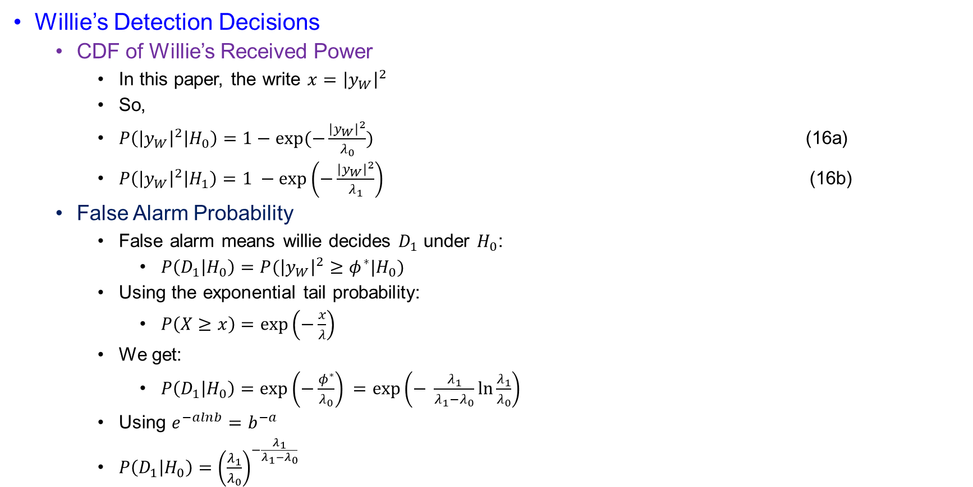
System Model
Willie’s Detection Decisions
  CDF of Willie’s Received Power
    In this paper, the write $x={\left|y_{W}\right|}^{2}$
    So,
    $P\left({\left|y_{W}\right|}^{2} | H_{0}\right)=1−\exp{(−\frac{{\left|y_{W}\right|}^{2}}{λ_{0}})}$ (16a)
    $P\left({\left|y_{W}\right|}^{2} | H_{1}\right)=1 −\exp\left(−\frac{{\left|y_{W}\right|}^{2}}{λ_{1}}\right)$ (16b)
  False Alarm Probability
    False alarm means willie decides $D_{1}$ under $H_{0}$:
      $P\left(D_{1} | H_{0}\right)=P({\left|y_{W}\right|}^{2}≥φ^{∗}|H_{0})$
    Using the exponential tail probability:
      $P\left(X≥x\right)=\exp\left(−\frac{x}{λ}\right)$
    We get:
      $P\left(D_{1} | H_{0}\right)=\exp\left(−\frac{φ^{∗}}{λ_{0}}\right) =\exp\left(− \frac{λ_{1}}{λ_{1}−λ_{0}}\ln{\frac{λ_{1}}{λ_{0}}}\right)$
    Using $e^{−alnb}=b^{−a}$
    $P\left(D_{1} | H_{0}\right)={\left(\frac{λ_{1}}{λ_{0}}\right)}^{−\frac{λ_{1}}{λ_{1}−λ_{0}}}$

Slide 33
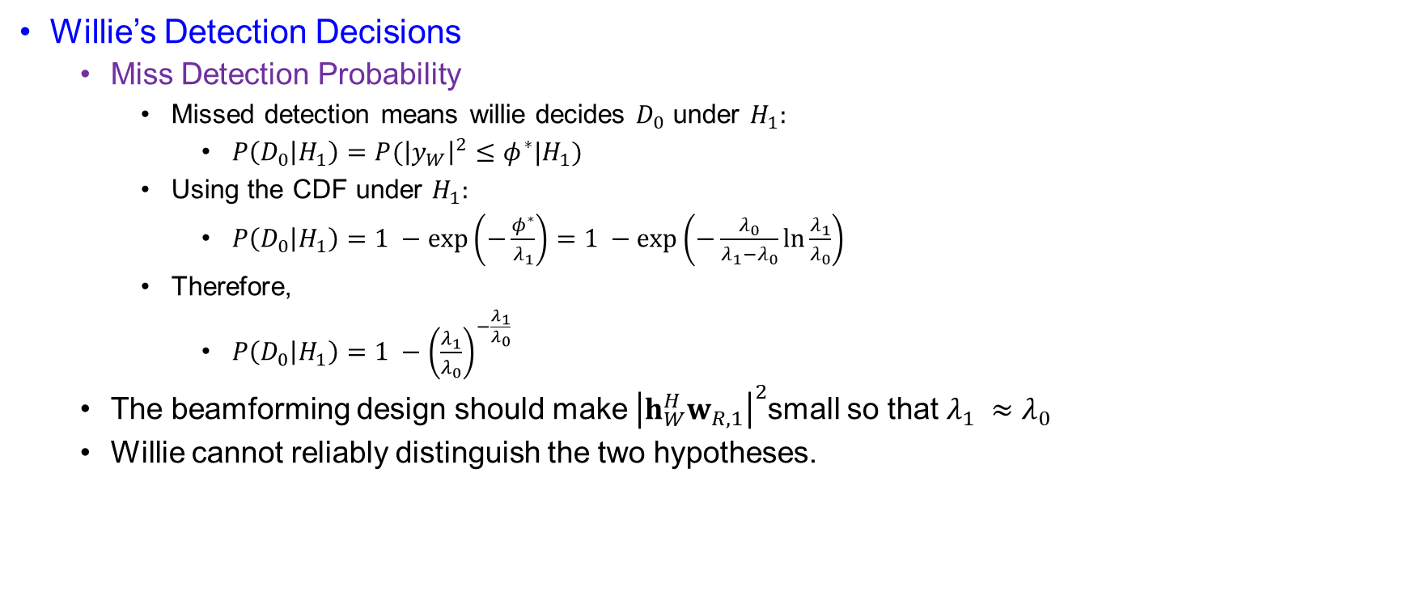
System Model
Willie’s Detection Decisions
  Miss Detection Probability
    Missed detection means willie decides $D_{0}$ under $H_{1}:$
      $P\left(D_{0} | H_{1}\right)=P({\left|y_{W}\right|}^{2}≤φ^{∗}|H_{1})$
    Using the CDF under $H_{1}:$
      $P\left(D_{0} | H_{1}\right)=1 −\exp\left(−\frac{φ^{∗}}{λ_{1}}\right)=1 −\exp\left(−\frac{λ_{0}}{λ_{1}−λ_{0}}\ln{\frac{λ_{1}}{λ_{0}}}\right)$
    Therefore,
      $P\left(D_{0} | H_{1}\right)=1 −{\left(\frac{λ_{1}}{λ_{0}}\right)}^{−\frac{λ_{1}}{λ_{0}}}$
  The beamforming design should make ${\left|h_{W}^{H}w_{R,1}\right|}^{2}$small so that $λ_{1} ≈λ_{0}$
  Willie cannot reliably distinguish the two hypotheses.

Slide 34
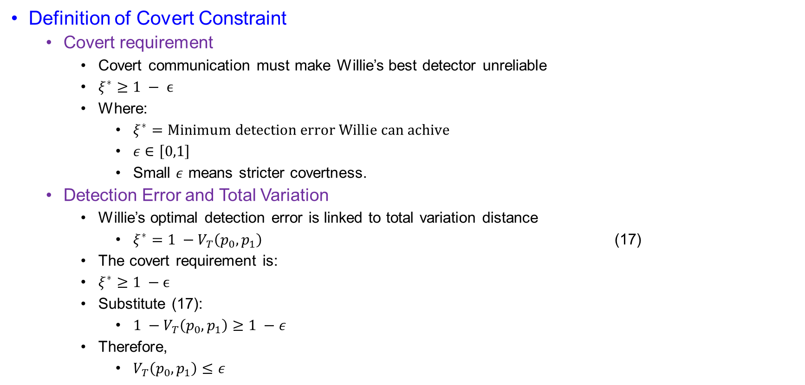
System Model
Definition of Covert Constraint
  Covert requirement
    Covert communication must make Willie’s best detector unreliable
    $ξ^{∗}≥1 − ϵ$
    Where:
      $ξ^{∗}=Minimum detection error Willie can achive$
      $ε∈\left[0,1\right]$
      Small $ε$ means stricter covertness.
  Detection Error and Total Variation
    Willie’s optimal detection error is linked to total variation distance
      $ξ^{∗}=1 −V_{T}\left(p_{0},p_{1}\right)$ (17)
    The covert requirement is:
    $ξ^{∗}≥1 −ϵ$
    Substitute (17):
      $1 −V_{T}\left(p_{0},p_{1}\right)≥1 −ε$
    Therefore,
      $V_{T}\left(p_{0},p_{1}\right)≤ε$

Slide 35
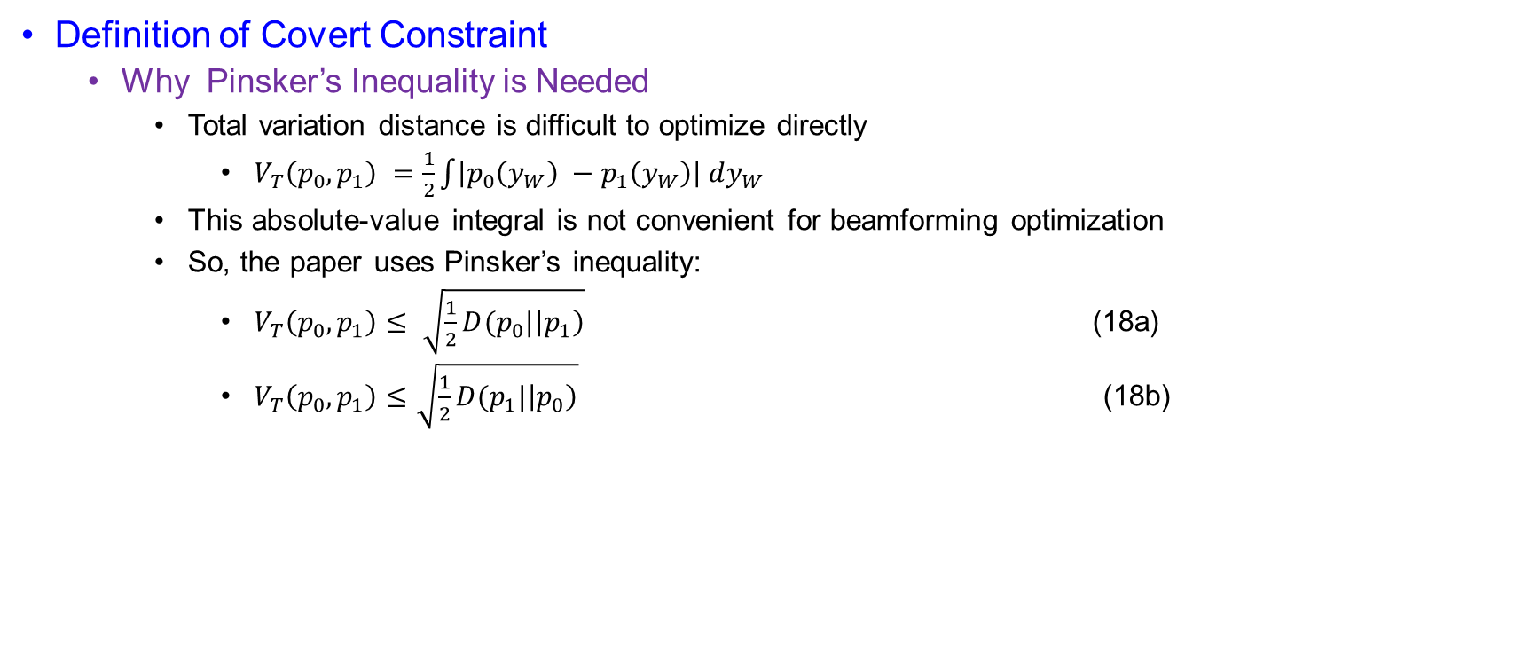
System Model
Definition of Covert Constraint
  Why Pinsker’s Inequality is Needed
    Total variation distance is difficult to optimize directly
      $V_{T}\left(p_{0},p_{1}\right) =\frac{1}{2}\int{\left|p_{0}\left(y_{W}\right) −p_{1}\left(y_{W}\right)\right| dy_{W}}$
    This absolute-value integral is not convenient for beamforming optimization
    So, the paper uses Pinsker’s inequality:
      $V_{T}\left(p_{0},p_{1}\right)≤ \sqrt{\frac{1}{2}D(p_{0}|\left|p_{1}\right)}$ (18a)
      $V_{T}\left(p_{0},p_{1}\right)≤\sqrt{\frac{1}{2}D(p_{1}|\left|p_{0}\right)}$ (18b)

Slide 36
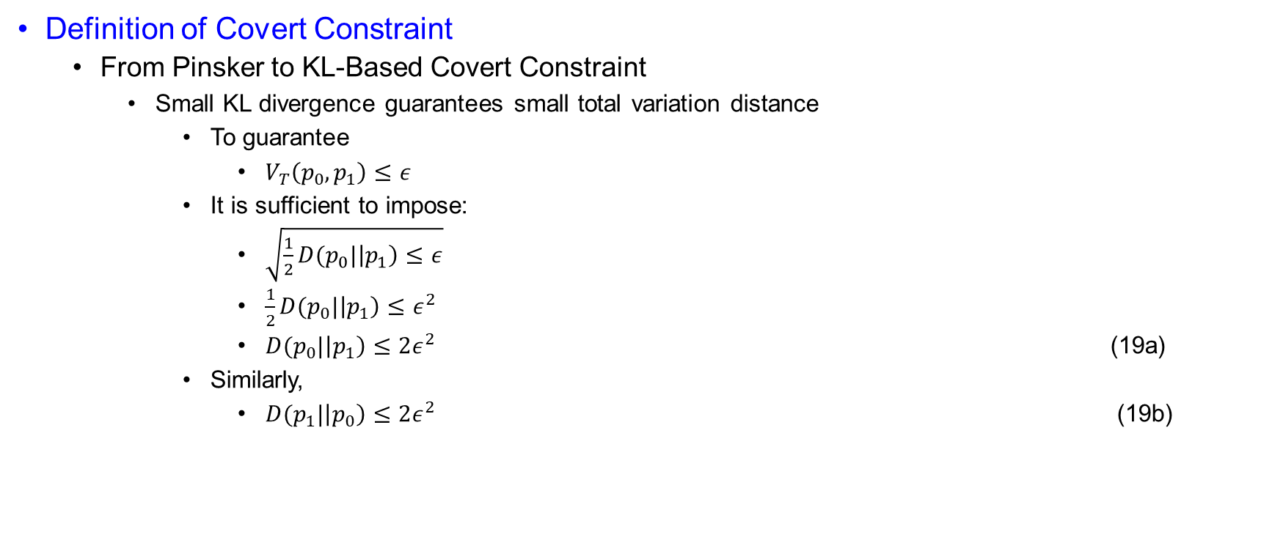
System Model
Definition of Covert Constraint
  From Pinsker to KL-Based Covert Constraint
    Small KL divergence guarantees small total variation distance
      To guarantee
        $V_{T}\left(p_{0},p_{1}\right)≤ε$
      It is sufficient to impose:
        $\sqrt{\frac{1}{2}D(p_{0}|\left|p_{1}\right)≤ε}$
        $\frac{1}{2}D(p_{0}|\left|p_{1}\right)≤ε^{2}$
        $D(p_{0}|\left|p_{1}\right)≤2ε^{2}$ (19a)
      Similarly,
        $D(p_{1}|\left|p_{0}\right)≤2ε^{2}$ (19b)

Slide 37
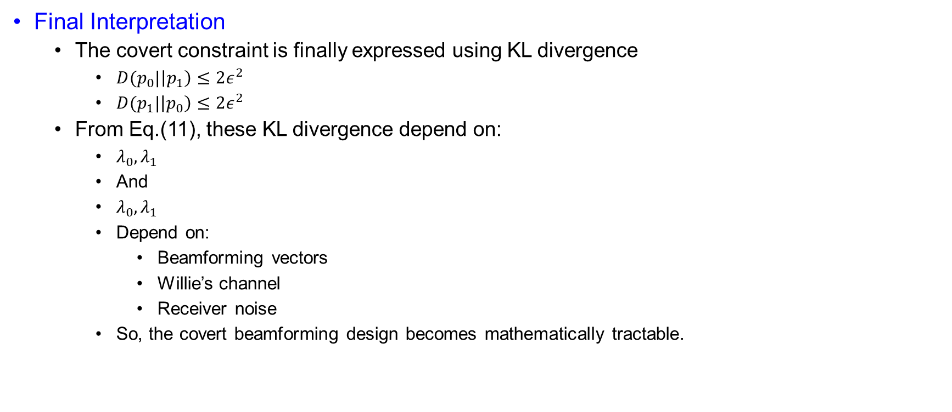
System Model
Final Interpretation
  The covert constraint is finally expressed using KL divergence
    $D(p_{0}|\left|p_{1}\right)≤2ε^{2}$
    $D(p_{1}|\left|p_{0}\right)≤2ε^{2}$
  From Eq.(11), these KL divergence depend on:
    $λ_{0},λ_{1}$
    And
    $λ_{0},λ_{1}$
    Depend on:
      Beamforming vectors
      Willie’s channel
      Receiver noise
    So, the covert beamforming design becomes mathematically tractable.

Slide 38
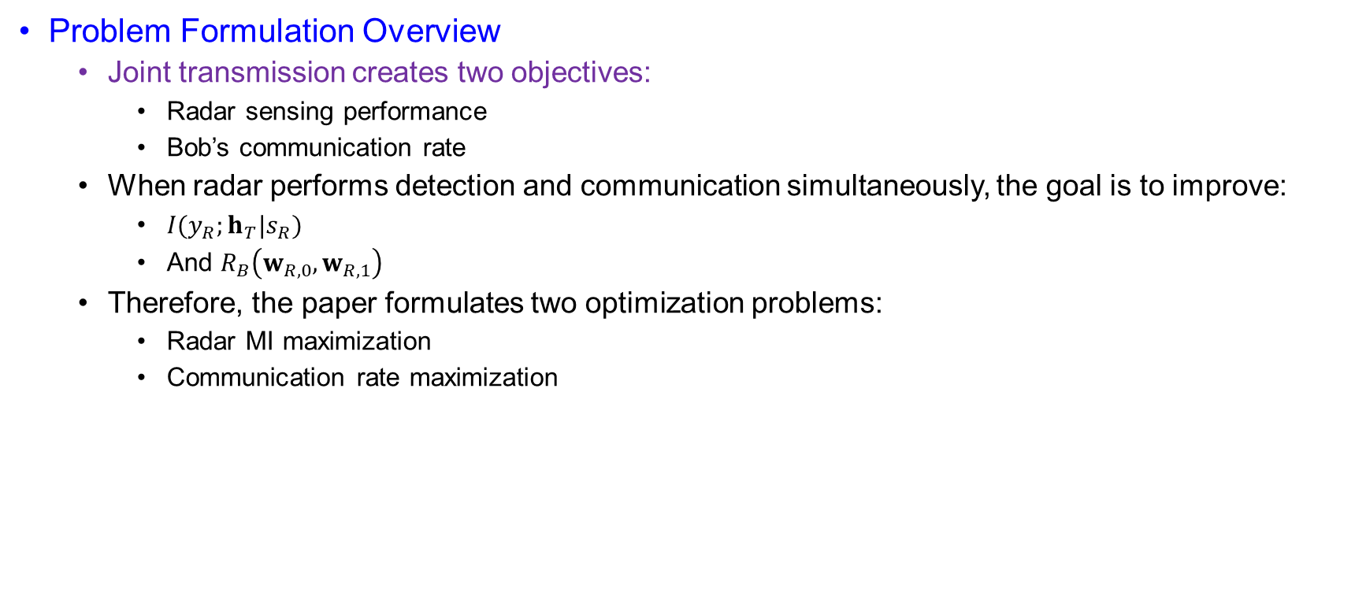
Problem Formulation
Problem Formulation Overview
  Joint transmission creates two objectives:
    Radar sensing performance
    Bob’s communication rate
  When radar performs detection and communication simultaneously, the goal is to improve:
    $I(y_{R};h_{T}|s_{R})$
    And $R_{B}\left(w_{R,0},w_{R,1}\right)$
  Therefore, the paper formulates two optimization problems:
    Radar MI maximization
    Communication rate maximization

Slide 39

Problem Formulation
MI Maximization Problem
  Maximize radar sensing information while guaranteeing Bob’s rate and covertness
    $\max_{w_{R,0},w_{R,1}}{I(y_{R};h_{T}|s_{R}) }$ (20a)
    Subject to:
      $R_{B}\left(w_{R,0},w_{R,1}\right)≥β$ (20b)
      ${\left\|w_{R,0}\right\|}^{2}+ {\left\|w_{R,1}\right\|}^{2}≤P_{total}$ (20c)
      $\left(19a\right)$or $\left(19b\right)$
    Where:
      $β :minimum communication rate requirement$
      $P_{total}:maximum radar transmit power$
      $\left(19a\right)$or $\left(19b\right):KL−Based covert constraint$

Slide 40
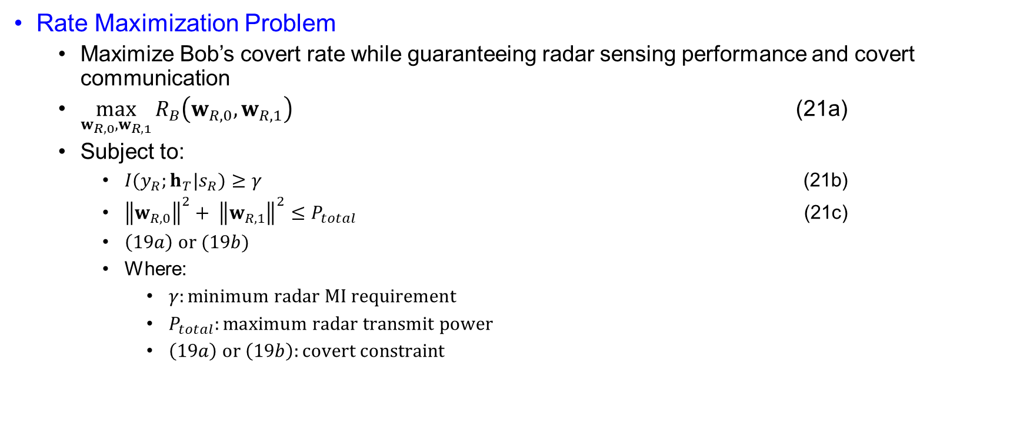
Problem Formulation
Rate Maximization Problem
  Maximize Bob’s covert rate while guaranteeing radar sensing performance and covert communication
  $\max_{w_{R,0},w_{R,1}}{R_{B}\left(w_{R,0},w_{R,1}\right)}$ (21a)
  Subject to:
    $I(y_{R};h_{T}|s_{R})≥γ$ (21b)
    ${\left\|w_{R,0}\right\|}^{2}+ {\left\|w_{R,1}\right\|}^{2}≤P_{total}$ (21c)
    $\left(19a\right) or (19b)$
    Where:
      $γ:minimum radar MI requirement$
      $P_{total}:maximum radar transmit power$
      $\left(19a\right) or \left(19b\right):covert constraint$

Slide 41
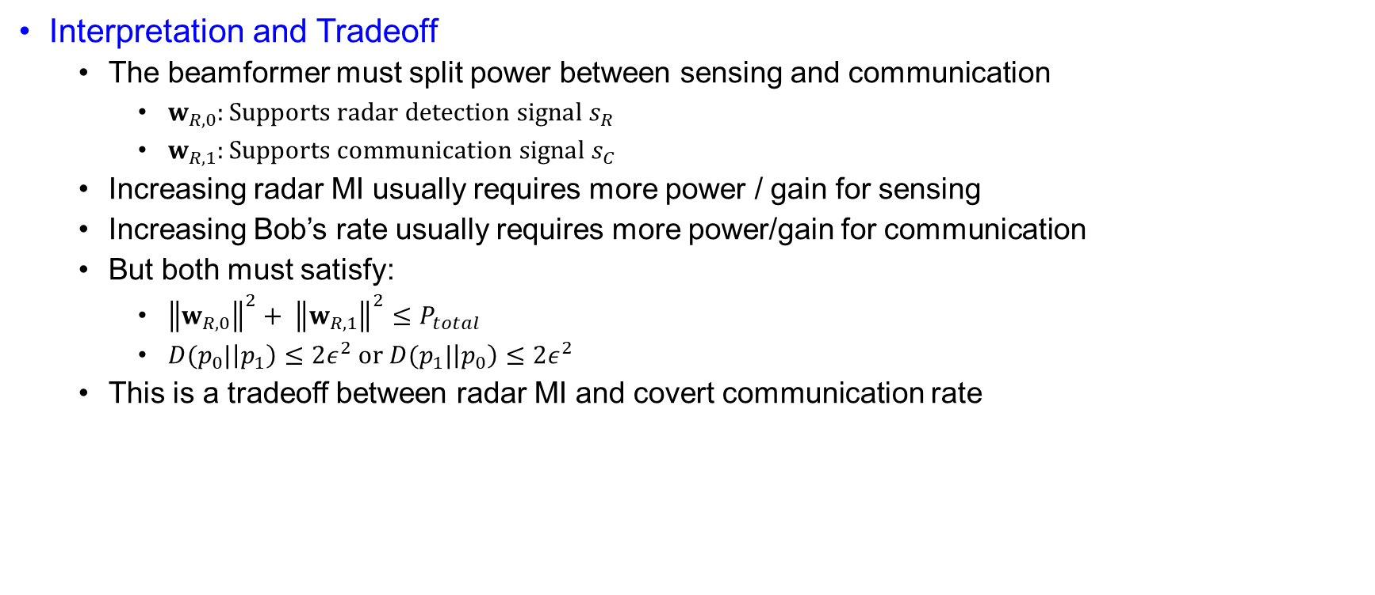
Problem Formulation
Interpretation and Tradeoff
  The beamformer must split power between sensing and communication
    $w_{R,0}:Supports radar detection signal s_{R}$
    $w_{R,1}:Supports communication signal s_{C}$
  Increasing radar MI usually requires more power / gain for sensing
  Increasing Bob’s rate usually requires more power/gain for communication
  But both must satisfy:
    ${\left\|w_{R,0}\right\|}^{2}+ {\left\|w_{R,1}\right\|}^{2}≤P_{total}$
    $D(p_{0}|\left|p_{1}\right)≤2ε^{2} or D(p_{1}|\left|p_{0}\right)≤2ε^{2}$
  This is a tradeoff between radar MI and covert communication rate

Slide 42
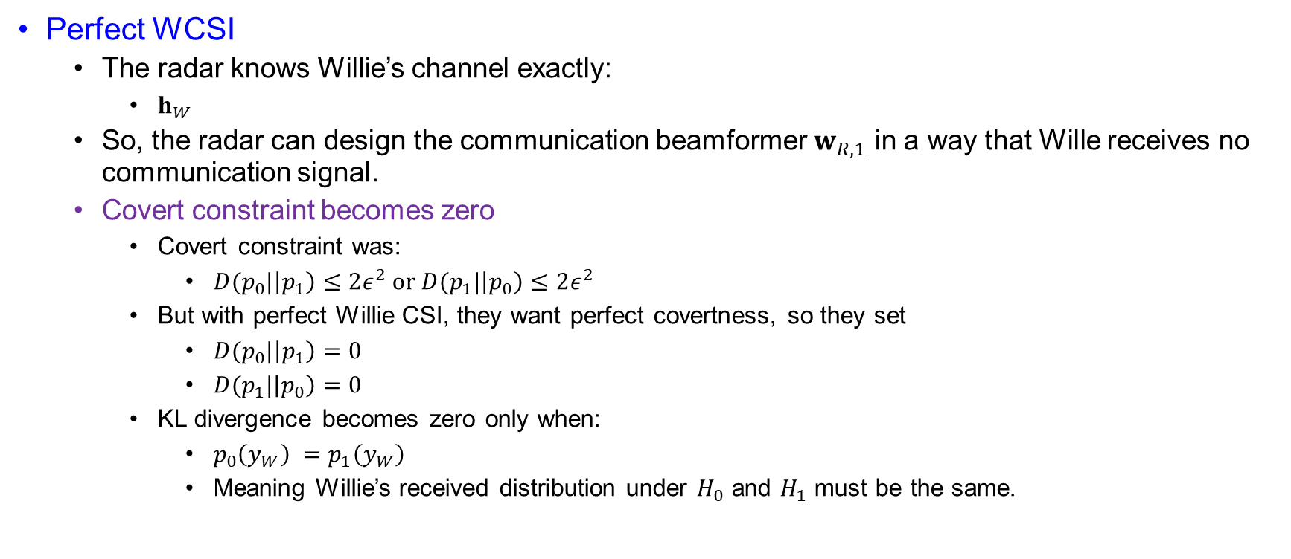
Beamforming Design Based on Perfect WCSI
Perfect WCSI
  The radar knows Willie’s channel exactly:
    $h_{W}$
  So, the radar can design the communication beamformer $w_{R,1}$ in a way that Wille receives no communication signal.
  Covert constraint becomes zero
    Covert constraint was:
      $D(p_{0}|\left|p_{1}\right)≤2ε^{2} or D(p_{1}|\left|p_{0}\right)≤2ε^{2}$
    But with perfect Willie CSI, they want perfect covertness, so they set
      $D(p_{0}|\left|p_{1}\right)=0$
      $D(p_{1}|\left|p_{0}\right)=0$
    KL divergence becomes zero only when:
      $p_{0}\left(y_{W}\right) =p_{1}\left(y_{W}\right)$
      Meaning Willie’s received distribution under $H_{0}$ and $H_{1}$ must be the same.

Slide 43
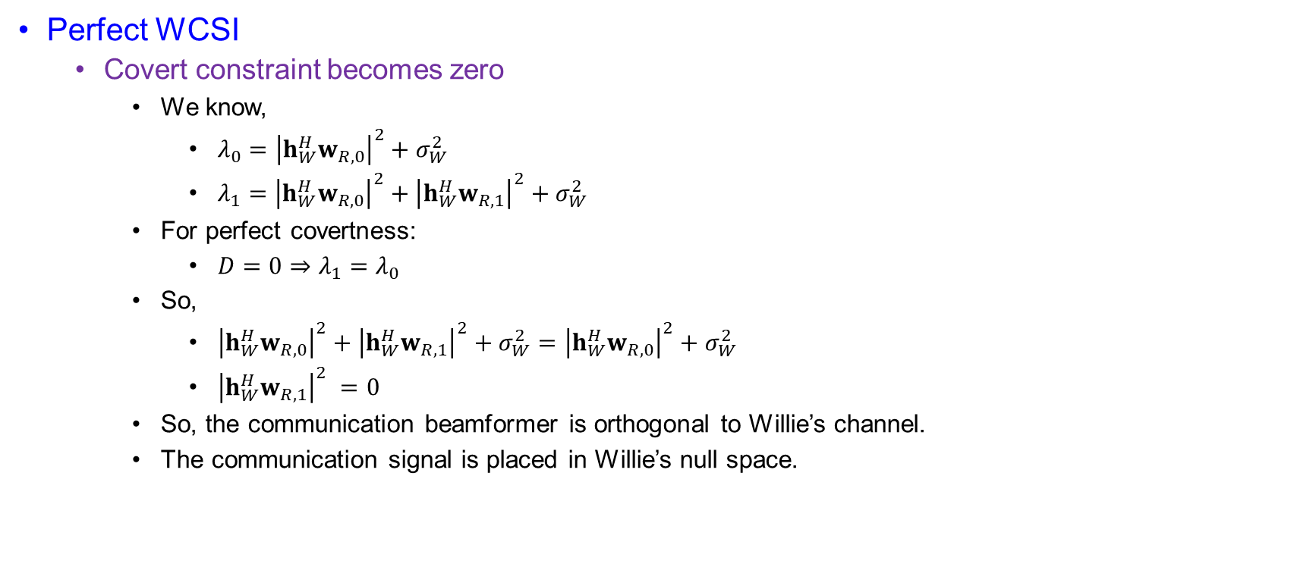
Beamforming Design Based on Perfect WCSI
Perfect WCSI
  Covert constraint becomes zero
    We know,
      $λ_{0}={\left|h_{W}^{H}w_{R,0}\right|}^{2}+σ_{W}^{2}$
      $λ_{1}={\left|h_{W}^{H}w_{R,0}\right|}^{2}+{\left|h_{W}^{H}w_{R,1}\right|}^{2}+σ_{W}^{2}$
    For perfect covertness:
      $D=0⇒λ_{1}=λ_{0}$
    So,
      ${\left|h_{W}^{H}w_{R,0}\right|}^{2}+{\left|h_{W}^{H}w_{R,1}\right|}^{2}+σ_{W}^{2}={\left|h_{W}^{H}w_{R,0}\right|}^{2}+σ_{W}^{2}$
      ${\left|h_{W}^{H}w_{R,1}\right|}^{2} =0$
    So, the communication beamformer is orthogonal to Willie’s channel.
    The communication signal is placed in Willie’s null space.

Slide 44
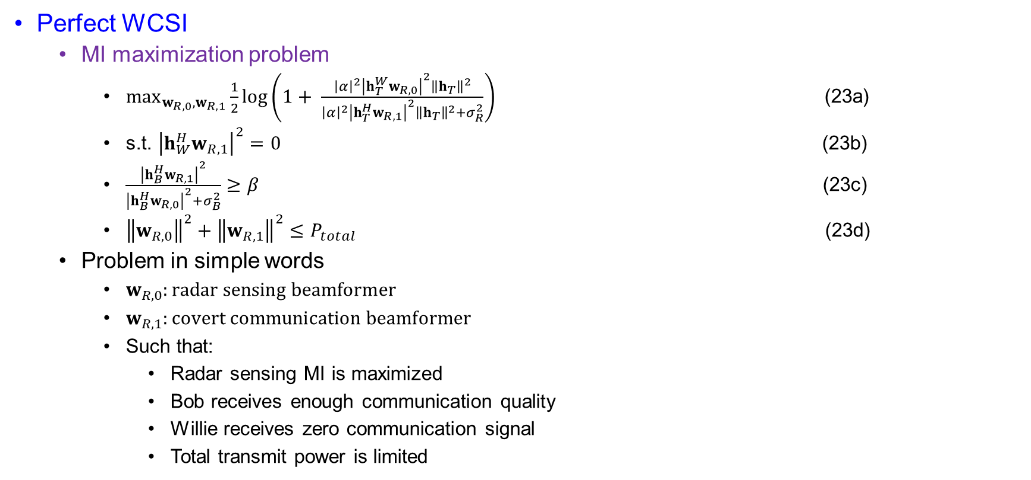
Beamforming Design Based on Perfect WCSI
Perfect WCSI
  MI maximization problem
    $\max_{w_{R,0},w_{R,1}}{\frac{1}{2}\log\left(1+ \frac{{\left|α\right|}^{2}{\left|h_{T}^{W}w_{R,0}\right|}^{2}{\left\|h_{T}\right\|}^{2}}{{\left|α\right|}^{2}{\left|h_{T}^{H}w_{R,1}\right|}^{2}{\left\|h_{T}\right\|}^{2}+σ_{R}^{2}}\right)}$ (23a)
    s.t. ${\left|h_{W}^{H}w_{R,1}\right|}^{2}=0$ (23b)
    $\frac{{\left|h_{B}^{H}w_{R,1}\right|}^{2}}{{\left|h_{B}^{H}w_{R,0}\right|}^{2}+σ_{B}^{2}}≥β$ (23c)
    ${\left\|w_{R,0}\right\|}^{2}+{\left\|w_{R,1}\right\|}^{2}≤P_{total}$ (23d)
  Problem in simple words
    $w_{R,0}:radar sensing beamformer$
    $w_{R,1}:covert communication beamformer$
    Such that:
      Radar sensing MI is maximized
      Bob receives enough communication quality
      Willie receives zero communication signal
      Total transmit power is limited

Slide 45
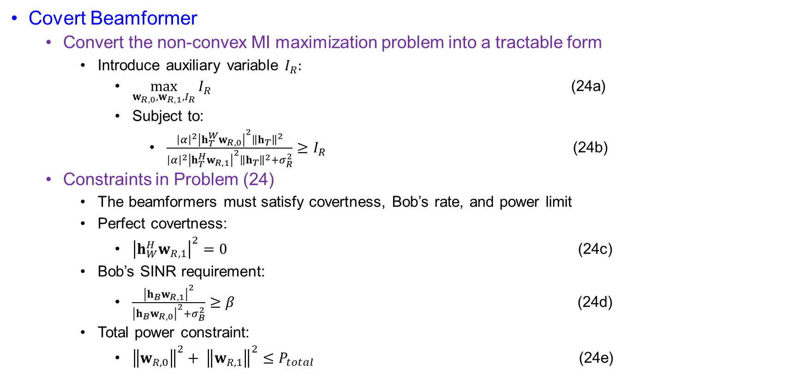
Beamforming Design Based on Perfect WCSI
Covert Beamformer
  Convert the non-convex MI maximization problem into a tractable form
    Introduce auxiliary variable $I_{R}:$
      $\max_{w_{R,0},w_{R,1},I_{R}}{I_{R}}$ (24a)
      Subject to:
        $\frac{{\left|α\right|}^{2}{\left|h_{T}^{W}w_{R,0}\right|}^{2}{\left\|h_{T}\right\|}^{2}}{{\left|α\right|}^{2}{\left|h_{T}^{H}w_{R,1}\right|}^{2}{\left\|h_{T}\right\|}^{2}+σ_{R}^{2}}≥I_{R}$ (24b)
  Constraints in Problem (24)
    The beamformers must satisfy covertness, Bob’s rate, and power limit
    Perfect covertness:
      ${\left|h_{W}^{H}w_{R,1}\right|}^{2}=0$ (24c)
    Bob’s SINR requirement:
      $\frac{{\left|h_{B}w_{R,1}\right|}^{2}}{{\left|h_{B}w_{R,0}\right|}^{2}+σ_{B}^{2}}≥β$ (24d)
    Total power constraint:
      ${\left\|w_{R,0}\right\|}^{2}+ {\left\|w_{R,1}\right\|}^{2}≤P_{total}$ (24e)

Slide 46

Beamforming Design Based on Perfect WCSI
Covert Beamformer
  Why SDR is Needed
    Problem (24) is non-convex because of quadratic beamforming terms.
    Typical term:
      ${\left|h^{H}w\right|}^{2}=w^{H}hh^{H}w$
    Using trace form:
      ${\left|h^{H}w\right|}^{2}=Tr(hh^{H}ww^{H})$
    Define lifted matrix:
      $W=ww^{H}$
    Then:
      ${\left|h^{H}w\right|}^{2}=Tr(hh^{H}W)$

Slide 47
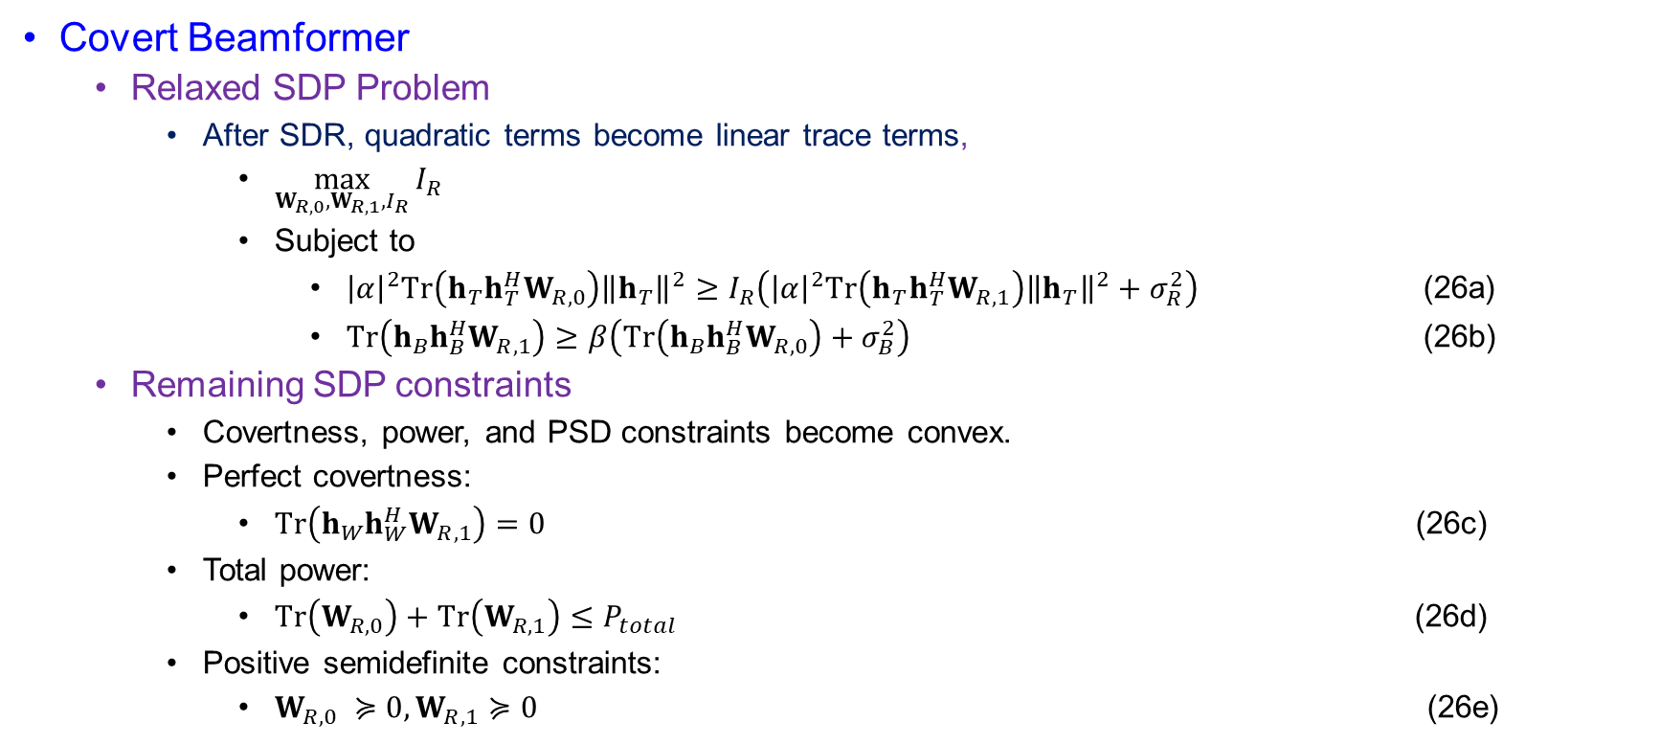
Beamforming Design Based on Perfect WCSI
Covert Beamformer
  Relaxed SDP Problem
    After SDR, quadratic terms become linear trace terms,
      $\max_{W_{R,0},W_{R,1},I_{R}}{I_{R}}$
      Subject to
        ${\left|α\right|}^{2}Tr\left(h_{T}h_{T}^{H}W_{R,0}\right){\left\|h_{T}\right\|}^{2}≥I_{R}\left({\left|α\right|}^{2}Tr\left(h_{T}h_{T}^{H}W_{R,1}\right){\left\|h_{T}\right\|}^{2}+σ_{R}^{2}\right)$ (26a)
        $Tr\left(h_{B}h_{B}^{H}W_{R,1}\right)≥β\left(Tr\left(h_{B}h_{B}^{H}W_{R,0}\right)+σ_{B}^{2}\right)$ (26b)
  Remaining SDP constraints
    Covertness, power, and PSD constraints become convex.
    Perfect covertness:
      $Tr\left(h_{W}h_{W}^{H}W_{R,1}\right)=0$ (26c)
    Total power:
      $Tr\left(W_{R,0}\right)+Tr\left(W_{R,1}\right)≤P_{total}$ (26d)
    Positive semidefinite constraints:
      $W_{R,0} ≽0, W_{R,1}≽0$ (26e)

Slide 48
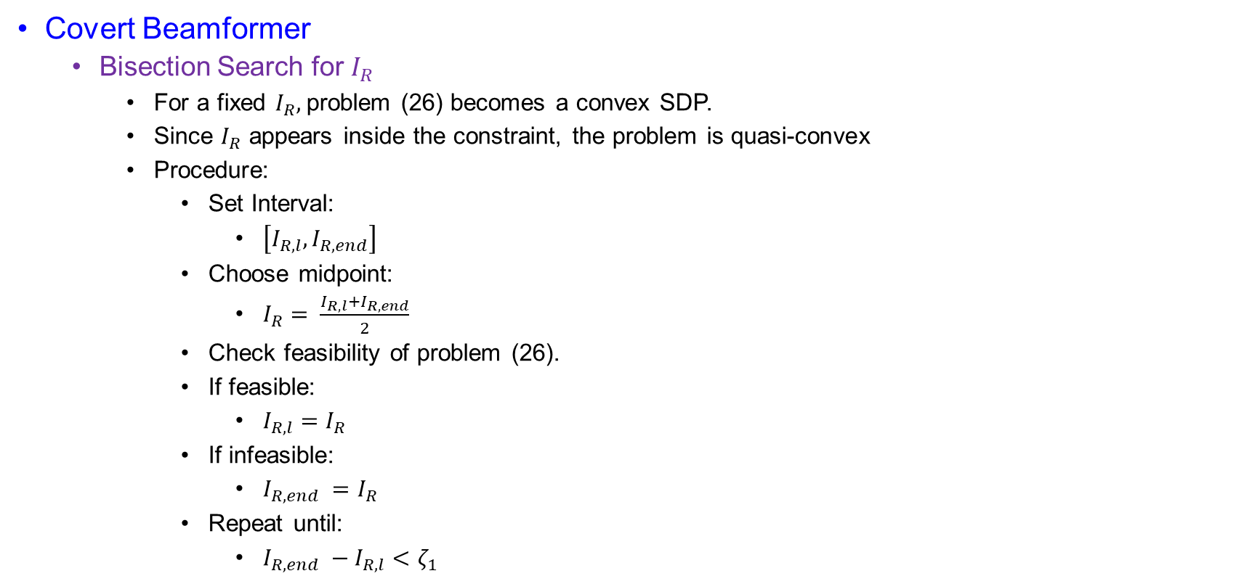
Beamforming Design Based on Perfect WCSI
Covert Beamformer
  Bisection Search for $I_{R}$
    For a fixed $I_{R},$problem (26) becomes a convex SDP.
    Since $I_{R}$ appears inside the constraint, the problem is quasi-convex
    Procedure:
      Set Interval:
        $\left[I_{R,l},I_{R,end}\right]$
      Choose midpoint:
        $I_{R}= \frac{I_{R,l}+I_{R,end}}{2}$
      Check feasibility of problem (26).
      If feasible:
        $I_{R,l}=I_{R}$
      If infeasible:
        $I_{R,end} =I_{R}$
      Repeat until:
        $I_{R,end} −I_{R,l}<ζ_{1}$

Slide 49
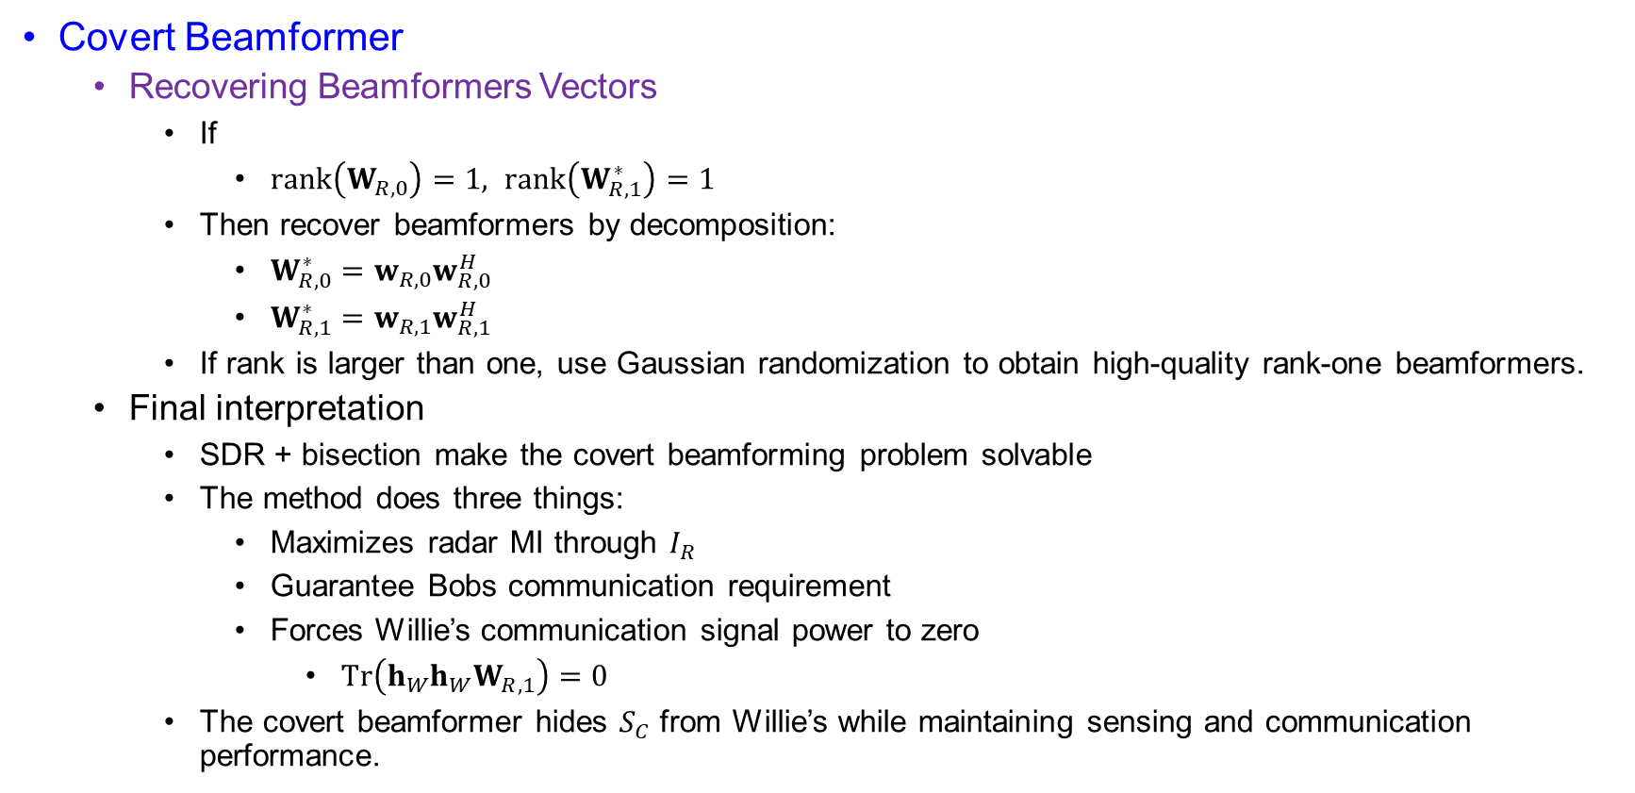
Beamforming Design Based on Perfect WCSI
Covert Beamformer
  Recovering Beamformers Vectors
    If
      $rank\left(W_{R,0}\right)=1, rank\left(W_{R,1}^{∗}\right)=1$
    Then recover beamformers by decomposition:
      $W_{R,0}^{∗}=w_{R,0}w_{R,0}^{H}$
      $W_{R,1}^{∗}=w_{R,1}w_{R,1}^{H}$
    If rank is larger than one, use Gaussian randomization to obtain high-quality rank-one beamformers.
  Final interpretation
    SDR + bisection make the covert beamforming problem solvable
    The method does three things:
      Maximizes radar MI through $I_{R}$
      Guarantee Bobs communication requirement
      Forces Willie’s communication signal power to zero
        $Tr\left(h_{W}h_{W}W_{R,1}\right)=0$
    The covert beamformer hides $S_{C}$ from Willie’s while maintaining sensing and communication performance.

Slide 50

Beamforming Design Based on Perfect WCSI
Zero-Forcing Beamformers
  Main idea
    Remove harmful interference by forcing selected signal components to zero
      $h_{W}^{H}w_{R,1}=0$
      $h_{T}^{H}w_{R,1} =0$
      $h_{B}^{H}w_{R,0}=0$
    So:
      $S_{C}$ is hidden from Willie
      $S_{C}$ does not interfere with radar sensing
      $S_{R}$ does not interfere with Bob

Slide 51
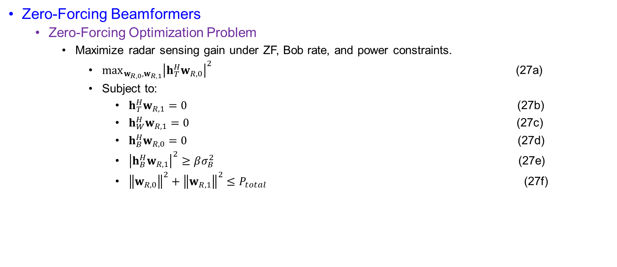
Beamforming Design Based on Perfect WCSI
Zero-Forcing Beamformers
  Zero-Forcing Optimization Problem
    Maximize radar sensing gain under ZF, Bob rate, and power constraints.
      $\max_{w_{R,0},w_{R,1}}{{\left|h_{T}^{H}w_{R,0}\right|}^{2}}$ (27a)
      Subject to:
        $h_{T}^{H}w_{R,1}=0$ (27b)
        $h_{W}^{H}w_{R,1}=0$ (27c)
        $h_{B}^{H}w_{R,0}=0$ (27d)
        ${\left|h_{B}^{H}w_{R,1}\right|}^{2}≥βσ_{B}^{2}$ (27e)
        ${\left\|w_{R,0}\right\|}^{2}+{\left\|w_{R,1}\right\|}^{2}≤P_{total}$ (27f)

Slide 52
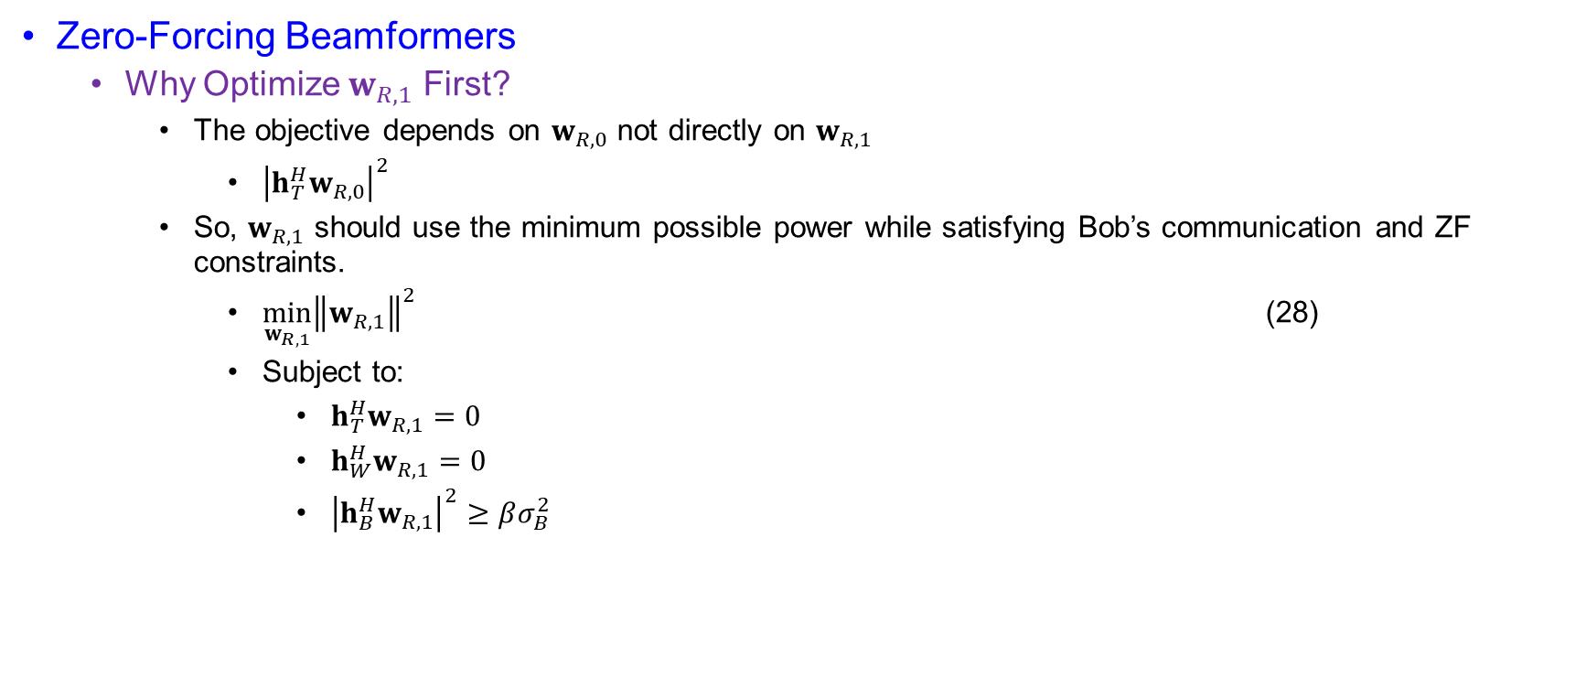
Beamforming Design Based on Perfect WCSI
Zero-Forcing Beamformers
  Why Optimize $w_{R,1}$ First?
    The objective depends on $w_{R,0}$ not directly on $w_{R,1}$
      ${\left|h_{T}^{H}w_{R,0}\right|}^{2}$
    So, $w_{R,1}$ should use the minimum possible power while satisfying Bob’s communication and ZF constraints.
      $\min_{w_{R,1}}{{\left\|w_{R,1}\right\|}^{2}}$ (28)
      Subject to:
        $h_{T}^{H}w_{R,1}=0$
        $h_{W}^{H}w_{R,1}=0$
        ${\left|h_{B}^{H}w_{R,1}\right|}^{2}≥βσ_{B}^{2}$

Slide 53
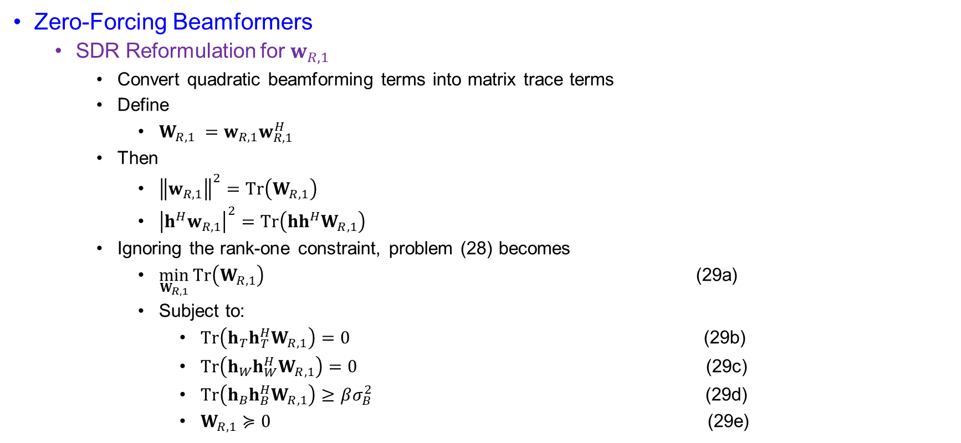
Beamforming Design Based on Perfect WCSI
Zero-Forcing Beamformers
  SDR Reformulation for $w_{R,1}$
    Convert quadratic beamforming terms into matrix trace terms
    Define
      $W_{R,1} =w_{R,1}w_{R,1}^{H}$
    Then
      ${\left\|w_{R,1}\right\|}^{2}=Tr\left(W_{R,1}\right)$
      ${\left|h^{H}w_{R,1}\right|}^{2}=Tr\left(hh^{H}W_{R,1}\right)$
    Ignoring the rank-one constraint, problem (28) becomes
      $\min_{W_{R,1}}{Tr\left(W_{R,1}\right)}$ (29a)
      Subject to:
        $Tr\left(h_{T}h_{T}^{H}W_{R,1}\right)=0$ (29b)
        $Tr\left(h_{W}h_{W}^{H}W_{R,1}\right)=0$ (29c)
        $Tr\left(h_{B}h_{B}^{H}W_{R,1}\right)≥βσ_{B}^{2}$ (29d)
        $W_{R,1}≽0$ (29e)

Slide 54
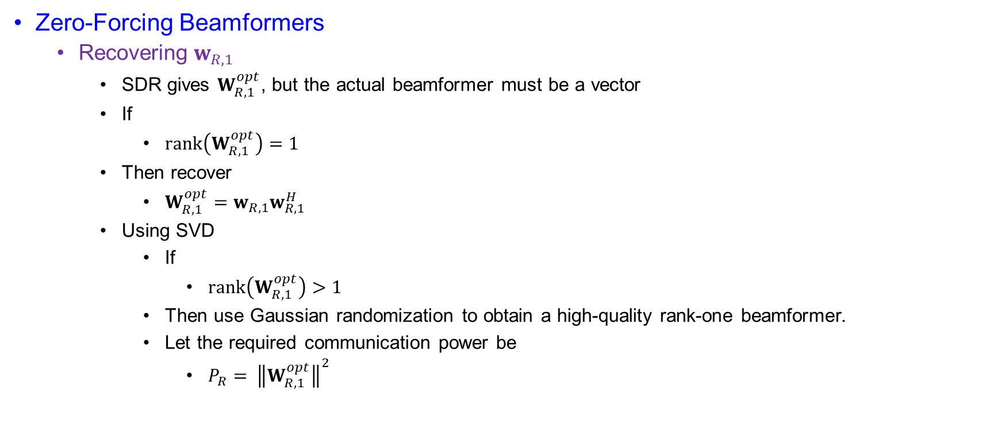
Beamforming Design Based on Perfect WCSI
Zero-Forcing Beamformers
  Recovering $w_{R,1}$
    SDR gives $W_{R,1}^{opt}$, but the actual beamformer must be a vector
    If
      $rank\left(W_{R,1}^{opt}\right)=1$
    Then recover
      $W_{R,1}^{opt}=w_{R,1}w_{R,1}^{H}$
    Using SVD
      If
        $rank\left(W_{R,1}^{opt}\right)>1$
      Then use Gaussian randomization to obtain a high-quality rank-one beamformer.
      Let the required communication power be
        $P_{R}= {\left\|W_{R,1}^{opt}\right\|}^{2}$

Slide 55
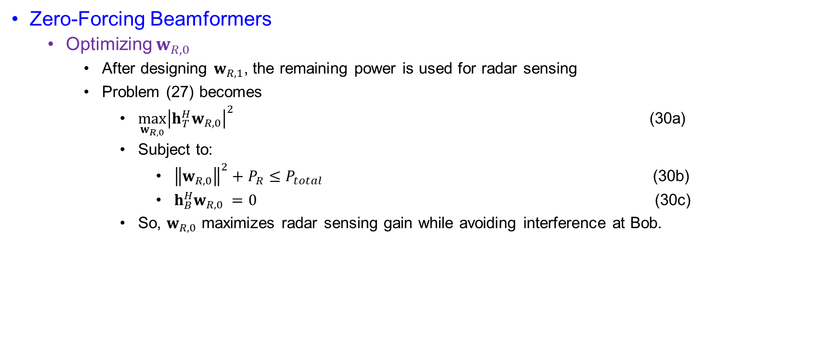
Beamforming Design Based on Perfect WCSI
Zero-Forcing Beamformers
  Optimizing $w_{R,0}$
    After designing $w_{R,1}$, the remaining power is used for radar sensing
    Problem (27) becomes
      $\max_{w_{R,0}}{{\left|h_{T}^{H}w_{R,0}\right|}^{2}}$ (30a)
      Subject to:
        ${\left\|w_{R,0}\right\|}^{2}+P_{R}≤P_{total}$ (30b)
        $h_{B}^{H}w_{R,0} =0$ (30c)
      So, $w_{R,0}$ maximizes radar sensing gain while avoiding interference at Bob.

Slide 56
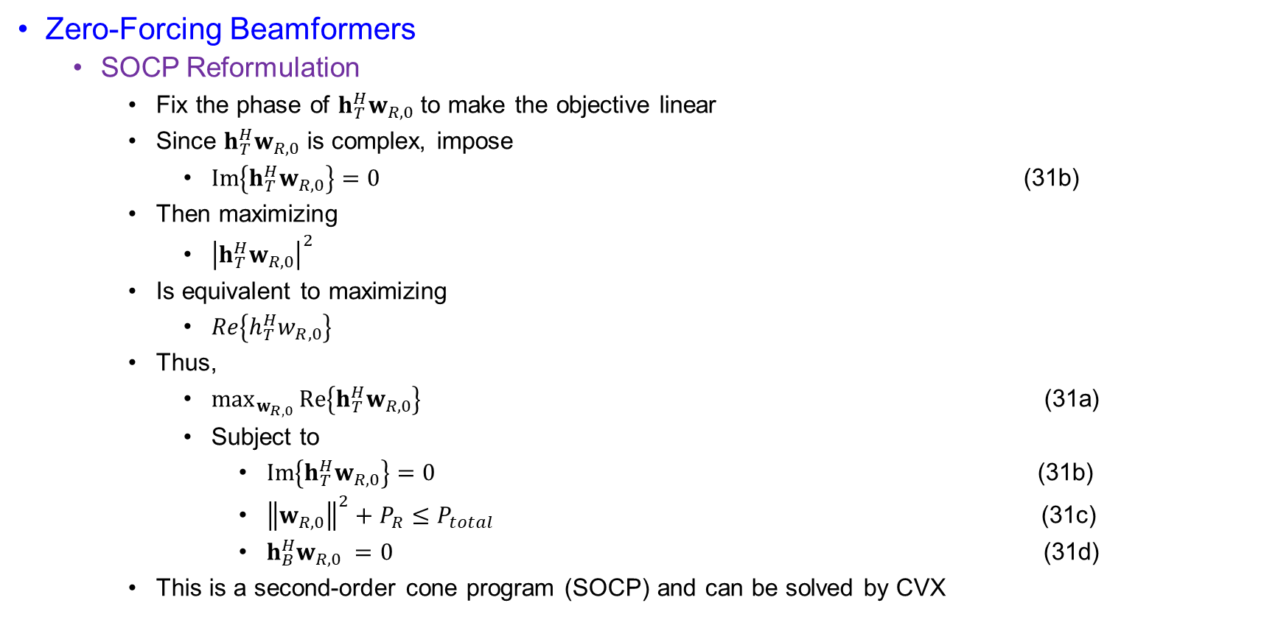
Beamforming Design Based on Perfect WCSI
Zero-Forcing Beamformers
  SOCP Reformulation
    Fix the phase of $h_{T}^{H}w_{R,0}$ to make the objective linear
    Since $h_{T}^{H}w_{R,0}$ is complex, impose
      $Im\left\{h_{T}^{H}w_{R,0}\right\}=0$ (31b)
    Then maximizing
      ${\left|h_{T}^{H}w_{R,0}\right|}^{2}$
    Is equivalent to maximizing
      $Re\left\{h_{T}^{H}w_{R,0}\right\}$
    Thus,
      $\max_{w_{R,0}}{Re\left\{h_{T}^{H}w_{R,0}\right\}}$ (31a)
      Subject to
        $Im\left\{h_{T}^{H}w_{R,0}\right\}=0$ (31b)
        ${\left\|w_{R,0}\right\|}^{2}+P_{R}≤P_{total}$ (31c)
        $h_{B}^{H}w_{R,0} =0$ (31d)
    This is a second-order cone program (SOCP) and can be solved by CVX

Slide 57
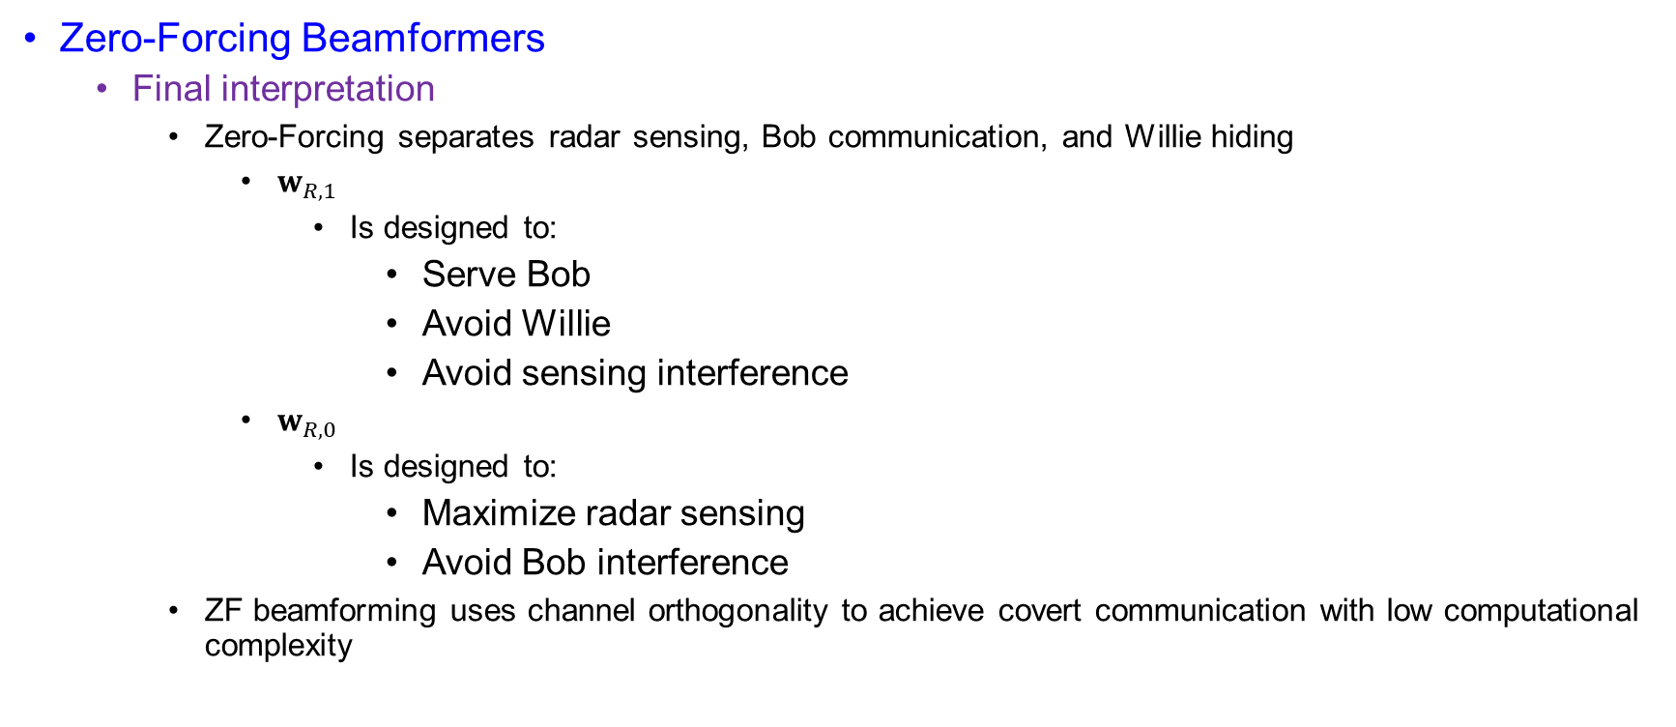
Beamforming Design Based on Perfect WCSI
Zero-Forcing Beamformers
  Final interpretation
    Zero-Forcing separates radar sensing, Bob communication, and Willie hiding
      $w_{R,1}$
        Is designed to:
          Serve Bob
          Avoid Willie
          Avoid sensing interference
      $w_{R,0}$
        Is designed to:
          Maximize radar sensing
          Avoid Bob interference
    ZF beamforming uses channel orthogonality to achieve covert communication with low computational complexity

Slide 58

Beamforming Design Based on Perfect WCSI
Rate Maximization
  Rate Maximization under Perfect WCSI
    Maximize Bob’s covert communication rate while ensuring perfect covertness, radar MI, and power limit.
    $\max_{w_{R,0},w_{R,1}}{R_{B}\left(w_{R,0},w_{R,1}\right)}$ (32a)
    Subject to
      $D(p_{0}|\left|p_{1}\right)=0$ (32b)
      $I(y_{R};h_{T}|s_{R})≥γ$ (32c)
      ${\left\|w_{R,0}\right\|}^{2}+{\left\|w_{R,1}\right\|}^{2}≤P_{total}$ (32d)

Slide 59

Beamforming Design Based on Perfect WCSI
Rate Maximization
  Equivalent Rate Maximization Form
    Since $\log_{2}\left(1+x\right)$ is increasing, maximizing Bob’s rate is equivalent to maximizing Bob’s SINR.
      $R_{B}=\log_{2}\left(1+ \frac{{\left|h_{B}^{H}w_{R,1}\right|}^{2}}{{\left|h_{B}^{H}w_{R,0}\right|}^{2}+σ_{B}^{2}}\right)$
    So, the objective becomes
      $\max_{w_{R,0},w_{R,1}}{\frac{{\left|h_{B}^{H}w_{R,1}\right|}^{2}}{{\left|h_{B}^{H}w_{R,0}\right|}^{2}+σ_{B}^{2}}}$ (33a)
    Perfect Covertness Constraint
      Perfect WCSI allows the communication signal to be nulled at Willie
      From
        $D(p_{0}|\left|p_{1}\right)=0$
      We need
        $p_{0}\left(y_{w}\right)=p_{1}\left(y_{w}\right)$
      Which requires
        $λ_{0}=λ_{1}$
      Since
        $λ_{1}=λ_{0}+{\left|h_{W}^{H}w_{R,1}\right|}^{2}$

Slide 60

Beamforming Design Based on Perfect WCSI
Rate Maximization
  Equivalent Rate Maximization Form
    We obtain
      ${\left|h_{W}^{H}w_{R,1}\right|}^{2}=0$ (33b)
    This means:
      $h_{W}^{H}w_{R,1}=0$
  Radar MI Requirement
    While maximizing Bob’s rate, radar sensing performance must still be guaranteed
      $\frac{1}{2}\log\left(1+ \frac{{\left|α\right|}^{2}\left|h_{T}^{H}w_{R,0}\right|{\left\|h_{T}\right\|}^{2}}{{\left|α\right|}^{2}{\left|h_{T}^{H}w_{R,1}\right|}^{2}{\left\|h_{T}\right\|}^{2}+σ_{R}^{2}}\right)≥γ$ (33c)

Slide 61

Beamforming Design Based on Imperfect WCSI
Imperfect WCSI Scenario
  Radar does not know Willie’s channel perfectly.
    $h_{W}={\hat{h}}_{W}+Δh_{W}$ (34a)
    where:
      ${\hat{h}}_{W}$: estimated Willie CSI
      $Δh_{W}$: CSI error
  The error is bounded by an ellipsoidal uncertainty region:
    $ℰ_{W}=\left\{Δh_{W}∣Δh_{W}^{H}C_{W}Δh_{W}≤ν_{W}\right\}$ (35a)

Slide 62

Beamforming Design Based on Imperfect WCSI
Imperfect WCSI Scenario
  Why Perfect Covertness is Difficult
    Since $h_{W}$ is uncertain, perfect nulling at Willie is difficult.
    For perfect WCSI:
      $h_{W}^{H}w_{R,1}=0$
    But with imperfect WCSI:
      ${\left({\hat{h}}_{W}+Δh_{W}\right)}^{H}w_{R,1}=0$
      Must hold for all possible $Δh_{W}$, which is difficult.
    Therefore, the paper uses KL-based covert constraints:
      $D\left(p_{0}∥p_{1}\right)≤2ε^{2}$ (19a)

Slide 63

Beamforming Design Based on Imperfect WCSI
Imperfect WCSI Scenario
  Case 1: MI Maximization with $D\left(p_{0}∥p_{1}\right)$
    Maximize radar MI while satisfying robust covertness, Bob’s rate, and power constraint.
      $\max_{w_{R,0},w_{R,1}}\frac{∣α∣^{2}∣h_{T}^{H}w_{R,0}∣^{2}∥h_{T}∥^{2}}{∣α∣^{2}∣h_{T}^{H}w_{R,1}∣^{2}∥h_{T}∥^{2}+σ_{R}^{2}}$ (36a)
      subject to
        $D\left(p_{0}∥p_{1}\right)≤2ε^{2}$ (36b)
        $\frac{∣h_{B}^{H}w_{R,1}∣^{2}}{∣h_{B}^{H}w_{R,0}∣^{2}+σ_{B}^{2}}≥β$ (36c)
        $∥w_{R,0}∥^{2}+∥w_{R,1}∥^{2}≤P_{\text{total}}$ (36d)
        $h_{W}={\hat{h}}_{W}+Δh_{W}$ (36e)

Slide 64

Beamforming Design Based on Imperfect WCSI
Imperfect WCSI Scenario
  Transforming the KL Constraint
    Rewrite the KL constraint using the ratio $λ_{1}/λ_{0}$.
    $D\left(p_{0}∥p_{1}\right)=\ln{\frac{λ_{1}}{λ_{0}}}+\frac{λ_{0}}{λ_{1}}−1≤2ε^{2}$
    Let
      $x=\frac{λ_{1}}{λ_{0}}$
    Then
      $\ln{x}+\frac{1}{x}−1≤2ε^{2}$
    The feasible range becomes
      $\overline{a}≤\frac{λ_{1}}{λ_{0}}≤\overline{b}$ (37)
    Where $\overline{a}$ and $\overline{b}$ are the two roots of
      $\ln{x}+\frac{1}{x}−1=2ε^{2}$

Slide 65

Beamforming Design Based on Imperfect WCSI
Imperfect WCSI Scenario
  Ratio Form of the Covert Constraint
    Substitute $λ_{0}$ and $λ_{1}$.
      $λ_{0}=∣h_{W}^{H}w_{R,0}∣^{2}+σ_{W}^{2}$
      $λ_{1}=∣h_{W}^{H}w_{R,0}∣^{2}+∣h_{W}^{H}w_{R,1}∣^{2}+σ_{W}^{2}$
    Thus,
      $\overline{a}≤\frac{∣h_{W}^{H}w_{R,0}∣^{2}+∣h_{W}^{H}w_{R,1}∣^{2}+σ_{W}^{2}}{∣h_{W}^{H}w_{R,0}∣^{2}+σ_{W}^{2}}≤\overline{b}$ (38)

Slide 66

Beamforming Design Based on Imperfect WCSI
Imperfect WCSI Scenario
  SDR Matrix Definitions
  Convert quadratic beamforming terms into matrix trace terms.
    Define
      $W_{R,0}=w_{R,0}w_{R,0}^{H}$
      $W_{R,1}=w_{R,1}w_{R,1}^{H}$
    Then define
      ${\hat{W}}_{1}≜\left(1−\overline{a}\right)W_{R,0}+W_{R,1}$
      ${\hat{W}}_{2}≜\left(1−\overline{b}\right)W_{R,0}+W_{R,1}$

Slide 67

Beamforming Design Based on Imperfect WCSI
Imperfect WCSI Scenario
  Robust Covert Constraints with CSI Error
    Substitute $h_{W}={\hat{h}}_{W}+Δh_{W}$.
    From the lower bound:
    $h_{W}^{H}{\hat{W}}_{1}h_{W}≥σ_{W}^{2}\left(\overline{a}−1\right)$
    We obtain
      $Δh_{W}^{H}{\hat{W}}_{1}Δh_{W}+2Re⁡\left\{Δh_{W}^{H}{\hat{W}}_{1}{\hat{h}}_{W}\right\}+{\hat{h}}_{W}^{H}{\hat{W}}_{1}{\hat{h}}_{W}≥σ_{W}^{2}\left(\overline{a}−1\right)$ (39a)
  Upper-Bound Robust Covert Constraint
    The upper bound gives the second quadratic constraint.
    From
      $h_{W}^{H}{\hat{W}}_{2}h_{W}≤σ_{W}^{2}\left(\overline{b}−1\right)$
    We obtain
      $Δh_{W}^{H}{\hat{W}}_{2}Δh_{W}+2Re⁡\left\{Δh_{W}^{H}{\hat{W}}_{2}{\hat{h}}_{W}\right\}+{\hat{h}}_{W}^{H}{\hat{W}}_{2}{\hat{h}}_{W}≤σ_{W}^{2}\left(\overline{b}−1\right)$ (39b)

Slide 68

Beamforming Design Based on Imperfect WCSI
Imperfect WCSI Scenario
  Need for S-Procedure
    $Δh_{W}∈ℰ_{W}$ creates infinitely many constraints.
    The uncertainty condition is
      $Δh_{W}^{H}C_{W}Δh_{W}≤ν_{W}$
    Constraints (39a) and (39b) must hold for every possible $Δh_{W}$ inside this ellipsoid.
    So, problem (40) is still difficult.
    The S-Procedure converts these infinite quadratic constraints into finite LMIs

Slide 69

Beamforming Design Based on Imperfect WCSI
Imperfect WCSI Scenario
  LMI from S-Procedure
    Robust covert constraints become finite SDP constraints.
    For (39a), there exists $η_{1}≥0$ such that
      $\left[\begin{matrix}{\hat{W}}_{1}+η_{1}C_{W} & {\hat{W}}_{1}{\hat{h}}_{W} \\ {\hat{h}}_{W}^{H}{\hat{W}}_{1} & {\hat{h}}_{W}^{H}{\hat{W}}_{1}{\hat{h}}_{W}−σ_{W}^{2}\left(\overline{a}−1\right)−η_{1}ν_{W}\end{matrix}\right]⪰0$ (43a)
    For (39b), there exists $η_{2}≥0$ such that
      $\left[\begin{matrix}−{\hat{W}}_{2}+η_{2}C_{W} & −{\hat{W}}_{2}{\hat{h}}_{W} \\ −{\hat{h}}_{W}^{H}{\hat{W}}_{2} & −{\hat{h}}_{W}^{H}{\hat{W}}_{2}{\hat{h}}_{W}+σ_{W}^{2}\left(\overline{b}−1\right)−η_{2}ν_{W}\end{matrix}\right]⪰0$ (43b)

Slide 70

Beamforming Design Based on Imperfect WCSI
Imperfect WCSI Scenario
  Final SDP Approximation
    After SDR and S-Procedure, the robust MI maximization becomes tractable.
    The conservative approximation is
      $\max_{W_{R,0},W_{R,1},{\tilde{I}}_{R}}{\tilde{I}}_{R}$ (44)
      subject to:
        $\left(40b\right), \left(40c\right), \left(43a\right), \left(43b\right), \left(40e\right), \left(40f\right)$
        For fixed ${\tilde{I}}_{R}$, problem (44) is a convex SDP.
        Therefore, it can be solved using:
          Convex optimization solver
          Bisection search over ${\tilde{I}}_{R}$

Slide 71

Beamforming Design Based on Imperfect WCSI
Imperfect WCSI Scenario
  Bisection Method for Robust MI Maximization
    For a fixed ${\tilde{I}}_{R}$, problem (44) becomes a convex SDP feasibility problem.
    The objective is:
      $\max{{\tilde{I}}_{R}}$
    However, ${\tilde{I}}_{R}$ appears inside constraint $\left(40b\right)$:
      $∣α∣^{2}Tr⁡\left(h_{T}h_{T}^{H}W_{R,0}\right)∥h_{T}∥^{2}≥{\tilde{I}}_{R}\left(∣α∣^{2}Tr⁡\left(h_{T}h_{T}^{H}W_{R,1}\right)∥h_{T}∥^{2}+σ_{R}^{2}\right)$ (40b)
    For a given value of ${\tilde{I}}_{R}$, this constraint becomes linear in $W_{R,0}$ and $W_{R,1}$.
    So, the authors use bisection to find the largest feasible ${\tilde{I}}_{R}$.

Slide 72

Beamforming Design Based on Imperfect WCSI
Imperfect WCSI Scenario
  Bisection Procedure
  Increase ${\tilde{I}}_{R}$ if the SDP is feasible; decrease it if infeasible.
  Initialize the search interval:
    ${\tilde{I}}_{R,l}=0, {\tilde{I}}_{R,end}={\hat{I}}_{R}$
  At each iteration:
    ${\tilde{I}}_{R,mid}=\frac{{\tilde{I}}_{R,l}+{\tilde{I}}_{R,end}}{2}$
  Then solve problem (44) with fixed ${\tilde{I}}_{R,mid}$.
  If problem (44) is feasible:
    ${\tilde{I}}_{R,l}={\tilde{I}}_{R,mid}$
  If problem (44) is infeasible:
    ${\tilde{I}}_{R,end}={\tilde{I}}_{R,mid}$
  Stop when:
    ${\tilde{I}}_{R,end}−{\tilde{I}}_{R,l}<ζ_{2}$
  Finally, output:
    $W_{R,0}^{∗}, W_{R,1}^{∗}$

Slide 73

Beamforming Design Based on Imperfect WCSI
Imperfect WCSI Scenario
  Why Bisection Works Here
    Larger ${\tilde{I}}_{R}$ means stricter radar MI requirement.
    If a large ${\tilde{I}}_{R}$ is feasible, then smaller values are also feasible.
    If a certain ${\tilde{I}}_{R}$ is infeasible, then larger values will also be infeasible.
    Therefore, the feasible set has a monotonic structure:
      $\text{S}\text{mall} {\tilde{I}}_{R}⇒\text{easy} \text{to} \text{satisfy}$
      $\text{L}\text{arge} {\tilde{I}}_{R}⇒\text{hard} \text{to} \text{satisfy}$
    This monotonicity allows bisection search to efficiently find the maximum achievable robust radar MI.

Slide 74

Beamforming Design Based on Imperfect WCSI
Final Interpretation
  Robust beamforming protects covertness even with uncertain Willie CSI.
  The method works as follows:
    Model Willie CSI uncertainty using an ellipsoid.
    Convert KL covert constraint into ratio bounds.
    Express ratio bounds as quadratic constraints in CSI error.
    Apply S-Procedure to obtain finite LMIs.
    Solve the resulting SDP using bisection.
    $\text{The} \text{beamformer} \text{is} \text{designed} \text{to} \text{remain} \text{covert} \text{for} \text{all} \text{possible} \text{Willie} \text{channels} \text{inside} \text{the} \text{uncertainty} \text{region}$

Slide 75

Beamforming Design Based on Imperfect WCSI
Imperfect WCSI Scenario
  Case 2: Robust MI Maximization
    This case uses the second KL covert constraint.
      $D\left(p_{1}∥p_{0}\right)≤2ε^{2}$
      Where:
        $D\left(p_{1}∥p_{0}\right)=\ln{\frac{λ_{0}}{λ_{1}}}+\frac{λ_{1}}{λ_{0}}−1$
    The robust MI maximization problem is
      $\max_{w_{R,0},w_{R,1}}\frac{∣α∣^{2}∣h_{T}^{H}w_{R,0}∣^{2}∥h_{T}∥^{2}}{∣α∣^{2}∣h_{T}^{H}w_{R,1}∣^{2}∥h_{T}∥^{2}+σ_{R}^{2}}$ (45a)
      subject to
        $D\left(p_{1}∥p_{0}\right)≤2ε^{2}$ (45b)
        $\frac{∣h_{B}^{H}w_{R,1}∣^{2}}{∣h_{B}^{H}w_{R,0}∣^{2}+σ_{B}^{2}}≥β$ (45c)
        $∥w_{R,0}∥^{2}+∥w_{R,1}∥^{2}≤P_{\text{total}}$ (45d)
        $h_{W}={\hat{h}}_{W}+Δh_{W}$ (45e)

Slide 76

Beamforming Design Based on Imperfect WCSI
Imperfect WCSI Scenario
  Transforming the Covert Constraint
    Rewrite $D\left(p_{1}∥p_{0}\right)$using the ratio $λ_{0}/λ_{1}$.
      $D\left(p_{1}∥p_{0}\right)=\ln{\frac{λ_{0}}{λ_{1}}}+\frac{λ_{1}}{λ_{0}}−1≤2ε^{2}$
    Let
      $x=\frac{λ_{0}}{λ_{1}}$
    Then
      $\frac{λ_{1}}{λ_{0}}=\frac{1}{x}$
    So,
      $\ln{x}+\frac{1}{x}−1≤2ε^{2}$
    The feasible range becomes
      $\overline{c}≤\frac{λ_{0}}{λ_{1}}≤\overline{d}$ (46)
    Where $\overline{c}$ and $\overline{d}$ are the two roots of
      $\ln{x}+\frac{1}{x}−1=2ε^{2}$

Slide 77

Beamforming Design Based on Imperfect WCSI
Imperfect WCSI Scenario
  Ratio Form with $λ_{0}$ and $λ_{1}$
    Substitute Willie’s received powers.
      $λ_{0}=∣h_{W}^{H}w_{R,0}∣^{2}+σ_{W}^{2}$
      $λ_{1}=∣h_{W}^{H}w_{R,0}∣^{2}+∣h_{W}^{H}w_{R,1}∣^{2}+σ_{W}^{2}$
    Thus,
      $\overline{c}≤\frac{∣h_{W}^{H}w_{R,0}∣^{2}+σ_{W}^{2}}{∣h_{W}^{H}w_{R,0}∣^{2}+∣h_{W}^{H}w_{R,1}∣^{2}+σ_{W}^{2}}≤\overline{d}$ (46)
    This constraint must hold under imperfect WCSI:
      $h_{W}={\hat{h}}_{W}+Δh_{W}$

Slide 78

Beamforming Design Based on Imperfect WCSI
Imperfect WCSI Scenario
  Solution Method
    Case 2 follows the same robust optimization procedure as Case 1.
    The main steps are:
      Convert the KL constraint into ratio bounds:
      $\overline{c}≤\frac{λ_{0}}{λ_{1}}≤\overline{d}$
    Substitute imperfect WCSI:
      $h_{W}={\hat{h}}_{W}+Δh_{W}$
    Reformulate the robust constraints as quadratic inequalities in $Δh_{W}$.
      Apply SDR:
        $W_{R,0}=w_{R,0}w_{R,0}^{H}$
        $W_{R,1}=w_{R,1}w_{R,1}^{H}$
    Apply S-Procedure to convert infinite uncertainty constraints into LMIs.
    Solve the final SDP using bisection.

Slide 79

Beamforming Design Based on Imperfect WCSI
Imperfect WCSI Scenario
  Key Difference from Case 1
    The method is similar, but the KL direction is different.
    Case 1 uses:
      $D\left(p_{0}∥p_{1}\right)≤2ε^{2}$
    which leads to
      $\overline{a}≤\frac{λ_{1}}{λ_{0}}≤\overline{b}$
    Case 2 uses:
      $D\left(p_{1}∥p_{0}\right)≤2ε^{2}$
    which leads to
      $\overline{c}≤\frac{λ_{0}}{λ_{1}}≤\overline{d}$
    Although both use SDR, S-Procedure, and bisection, the feasible beamforming region changes.

Slide 80

Beamforming Design Based on Imperfect WCSI
Robust Rate Maximization with Imperfect WCSI
  Perfect covertness is difficult when Willie’s CSI has estimation error.
    $h_{W}={\hat{h}}_{W}+Δh_{W}$
  So instead of
    $D\left(p_{0}∥p_{1}\right)=0$
  The paper uses relaxed covert constraints:
    $D\left(p_{0}∥p_{1}\right)≤2ε^{2}$
    or
    $D\left(p_{1}∥p_{0}\right)≤2ε^{2}$
  The goal is to maximize Bob’s rate while maintaining radar sensing, power limit, and covertness.

Slide 81

Beamforming Design Based on Imperfect WCSI
Main Optimization Idea
  Use the same robust optimization method as MI maximization.
    The beamformers are designed to satisfy:
      $\max{R_{B}}\left(w_{R,0} , w_{R,1}\right)$
      subject to:
        $I\left(y_{R} ; h_{T}∣s_{R}\right)≥γ$
        $∥w_{R,0}∥^{2}+∥w_{R,1}∥^{2}≤P_{\text{total}}$
        $D\left(p_{0}∥p_{1}\right)≤2ε^{2} \text{or} D\left(p_{1}∥p_{0}\right)≤2ε^{2}$
    Solution method:
      $\text{KL} \text{transformation}→\text{SDR}→\text{S}\text{−}\text{Procedure}→\text{SDP}$

